Slide 1


EOSC connects Europe’s high-quality
data to researchers and AI, opening
a new frontier in scientific discovery.
eosc.eu

Slide 2
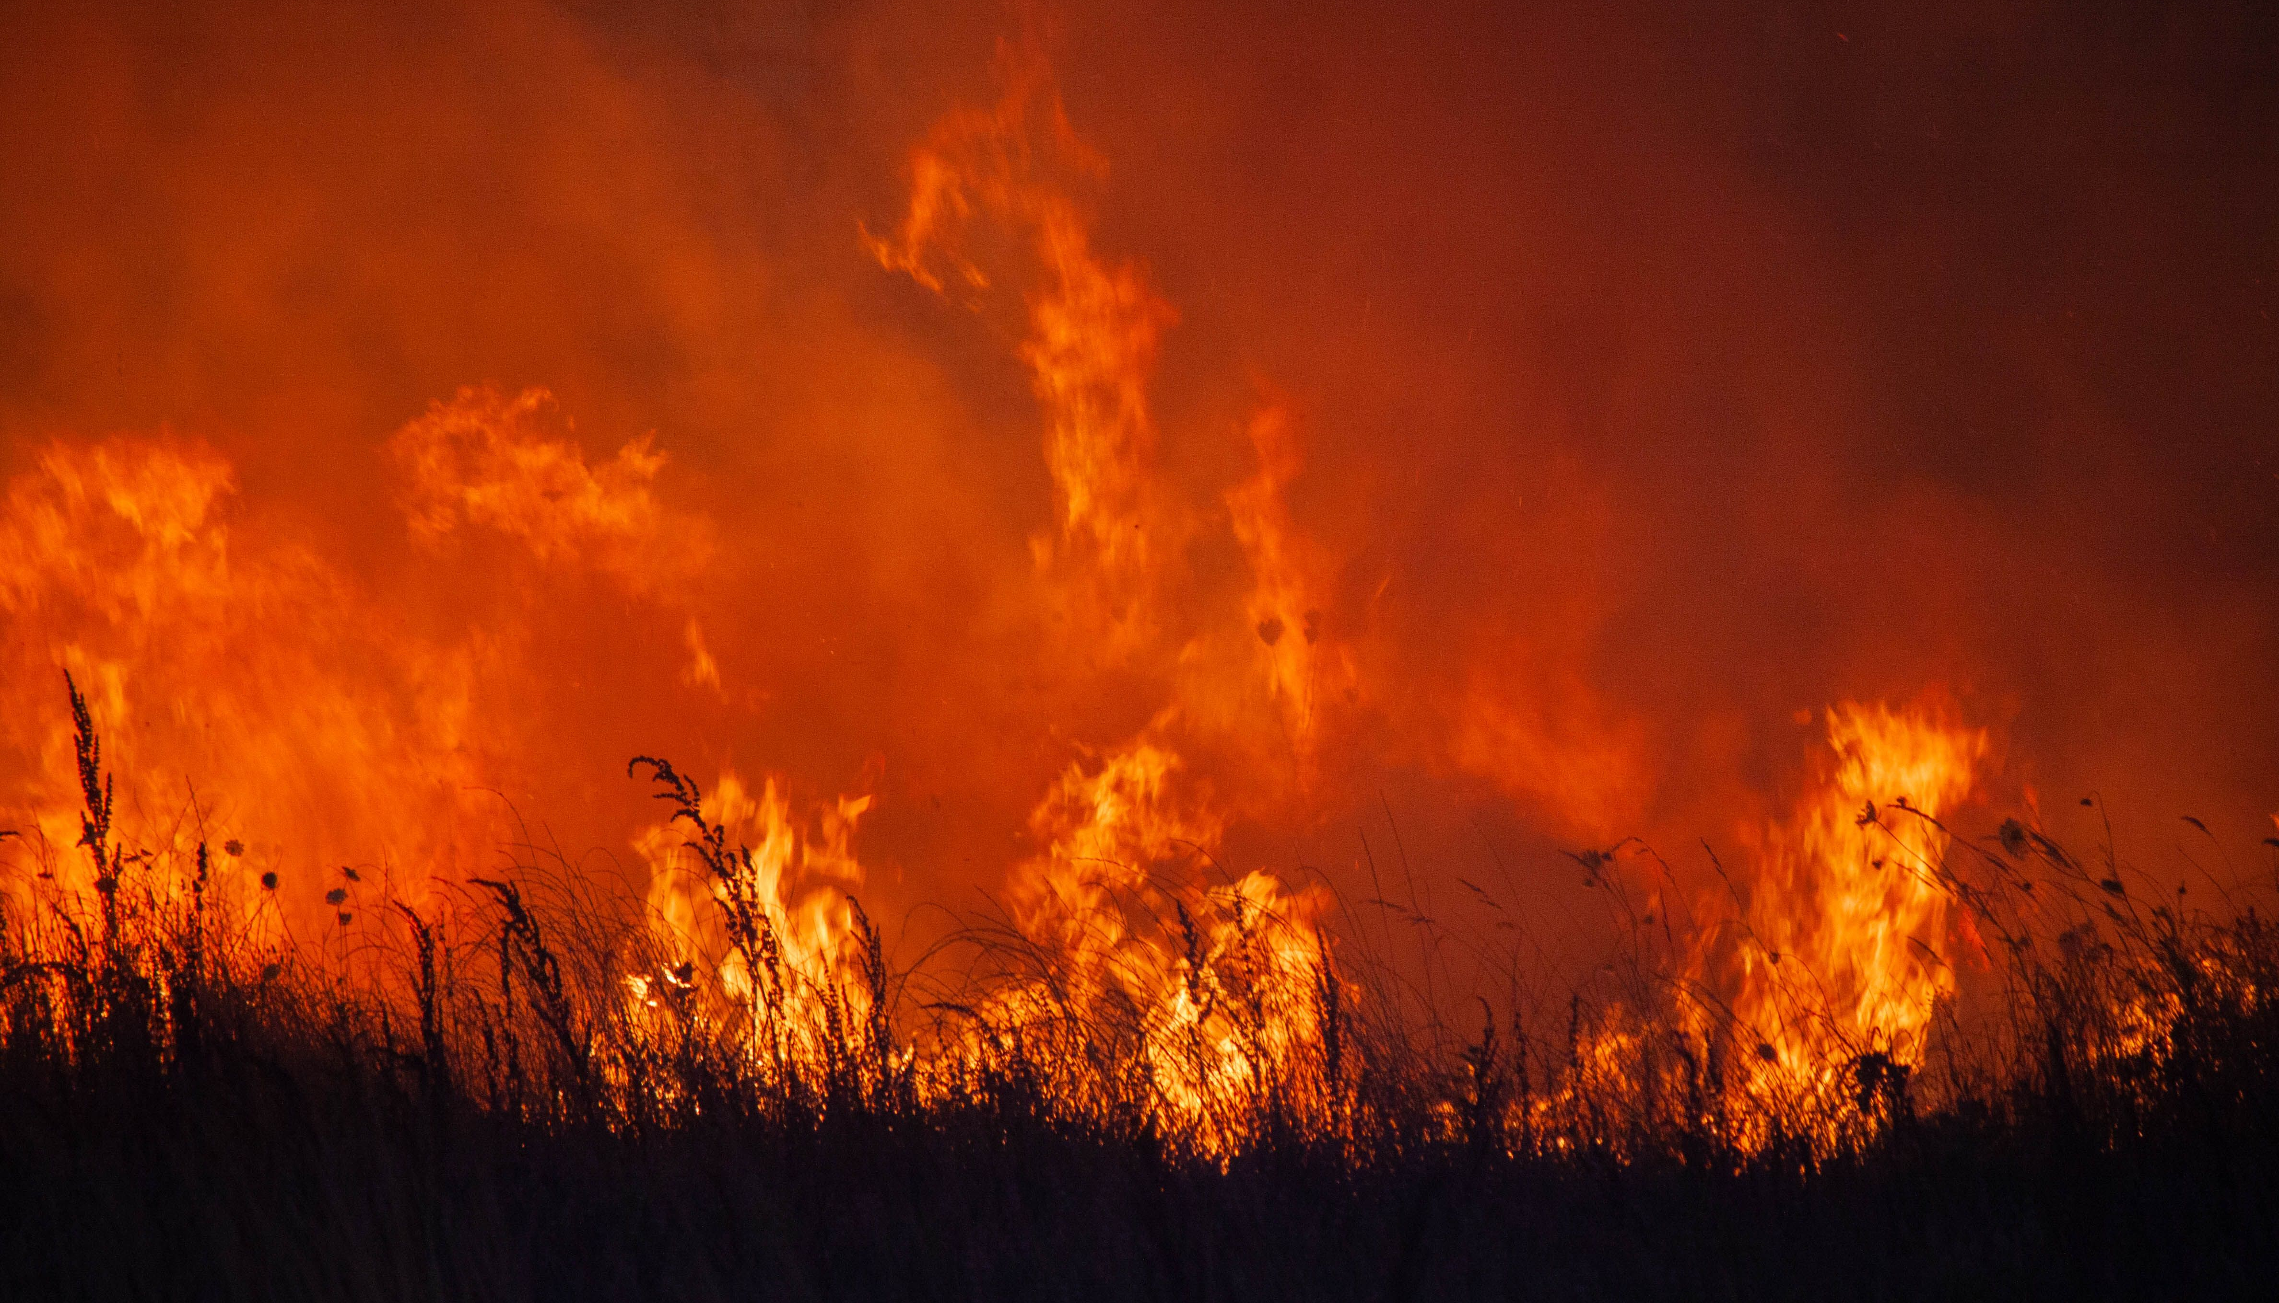
Understanding Europe’s wildfire data can save lives and property.
EOSC connects restricted
data sets responsibly.
Unlocking Europe’s wildfire data
Photo by Oscar Sánchez on Pexels
Notes:
Link to Jean-Claude Burgelman’s article ”Unlocking Europe’s wildfire data”: https://sciencebusiness.net/viewpoint/data/viewpoint-unlocking-europes-wildfire-data

Slide 3
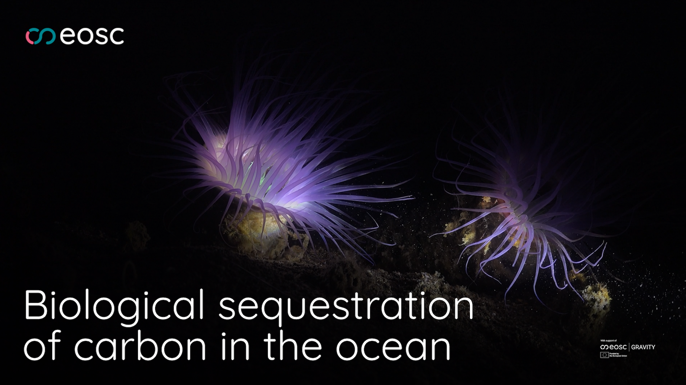
The ocean has vast potential
to mitigate climate change.
EOSC unlocks the research data.
eosc.eu
Watch the EOSC Federation use case video
Notes:
Link to use case on eosc.eu: https://eosc.eu/news/eosc-federation-use-case-biological-sequestration-of-carbon-in-the-ocean
Link to YouTube video: https://www.youtube.com/watch?v=yOh_96nyoJY

Slide 4

Better, faster AI-enabled cancer
diagnosis can be brought to
every hospital in Europe.
EOSC enables the safe
handling of sensitive data.
eosc.eu
Watch the EOSC Federation use case video
Notes:
Link to use case on eosc.eu: https://eosc.eu/news/eosc-federation-use-case-multi-centric-validation-of-ai-models-for-prostate-cancer-screening
Link to YouTube video: https://www.youtube.com/watch?v=UPtEFGLruh4

Slide 5
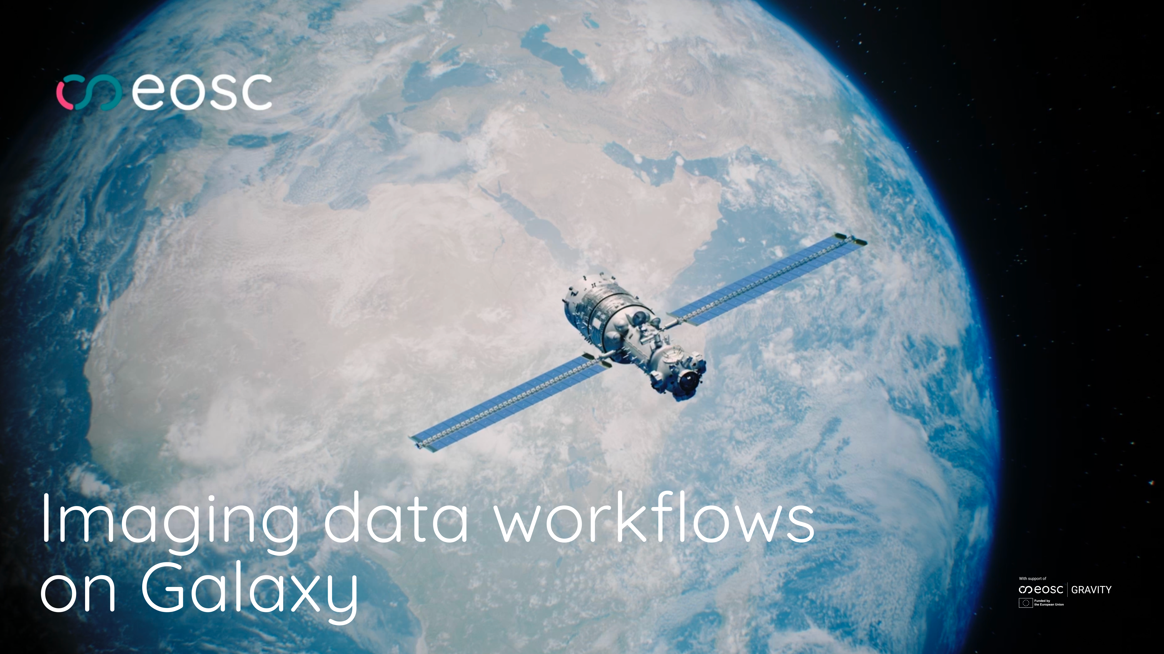
From cancer cells to galaxies, breakthroughs are made in the analysis of billions of images. EOSC brings this power to researchers.
eosc.eu
Watch the EOSC Federation use case video
Notes:
Link to use case on eosc.eu: https://eosc.eu/news/eosc-federation-use-case-imaging-data-workflows-on-galaxy
Link to YouTube video: https://www.youtube.com/watch?v=HlKlfSgDkuM

Slide 6
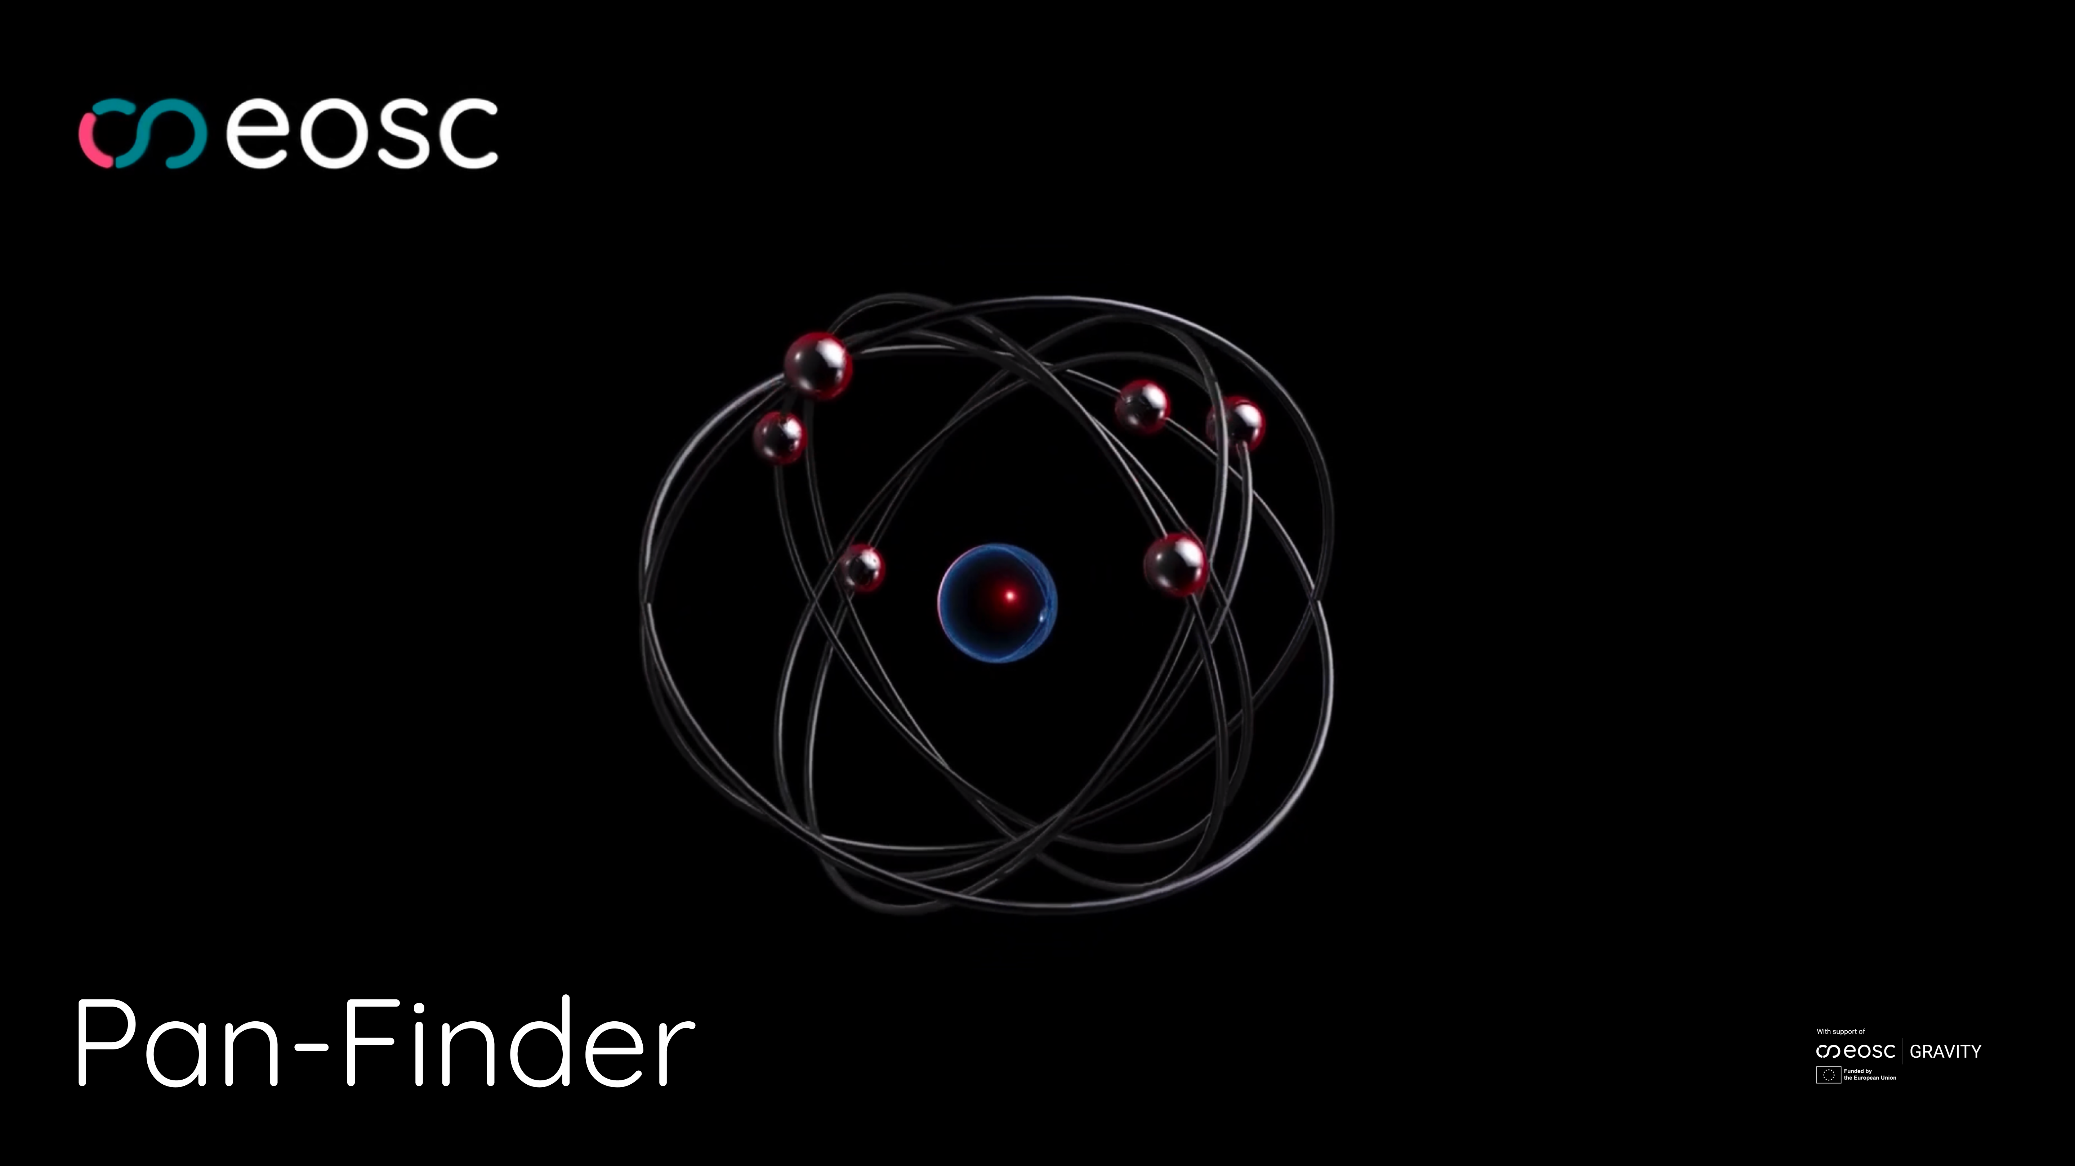
Europe’s large-scale research facilities have done the work
on tomorrow’s batteries,
medicines and materials.
EOSC exposes the data.
eosc.eu
Watch the EOSC Federation use case video
Notes:
Link to use case on eosc.eu: https://eosc.eu/news/eosc-federation-use-case-pan-finder
Link to YouTube video: https://www.youtube.com/watch?v=qH3-8nh34Ok

Slide 7
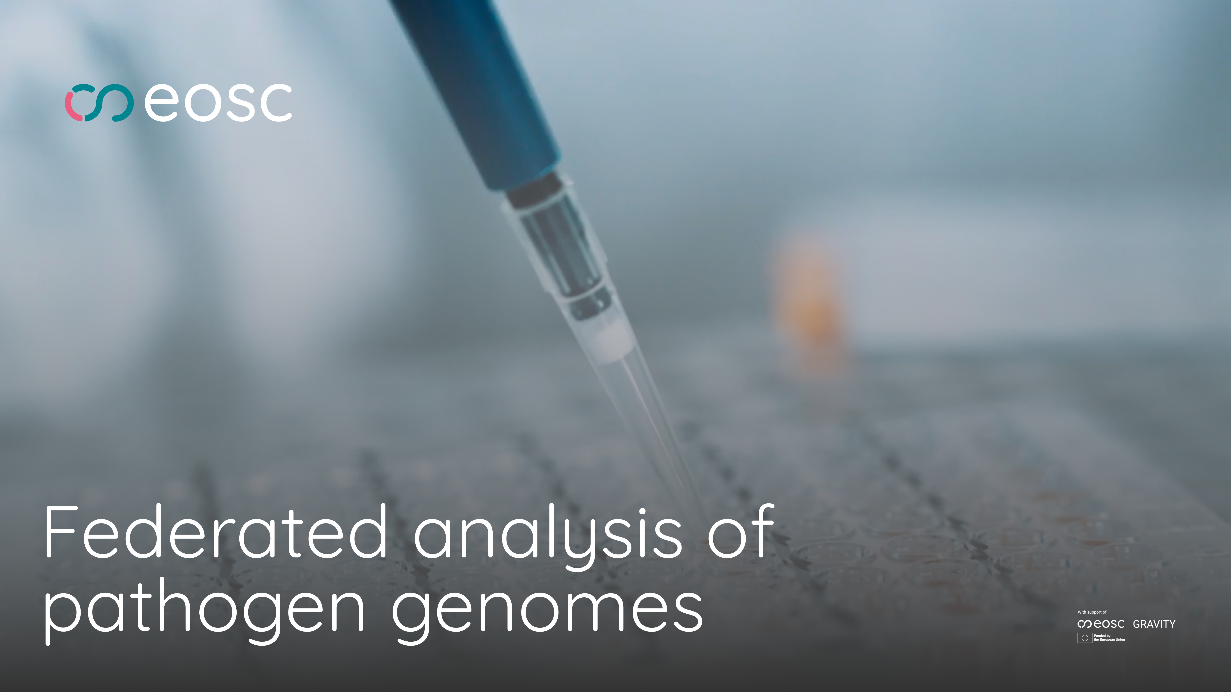
Pandemics and drug-resistant infections
can be identified before they spread.
EOSC connects the data across borders.
eosc.eu
Watch the EOSC Federation use case video
Notes:
Link to use case on eosc.eu: https://eosc.eu/news/eosc-federation-use-case-federated-analysis-of-pathogen-genomes
Link to YouTube video: https://www.youtube.com/watch?v=OC2ILB0PkTM

Slide 8
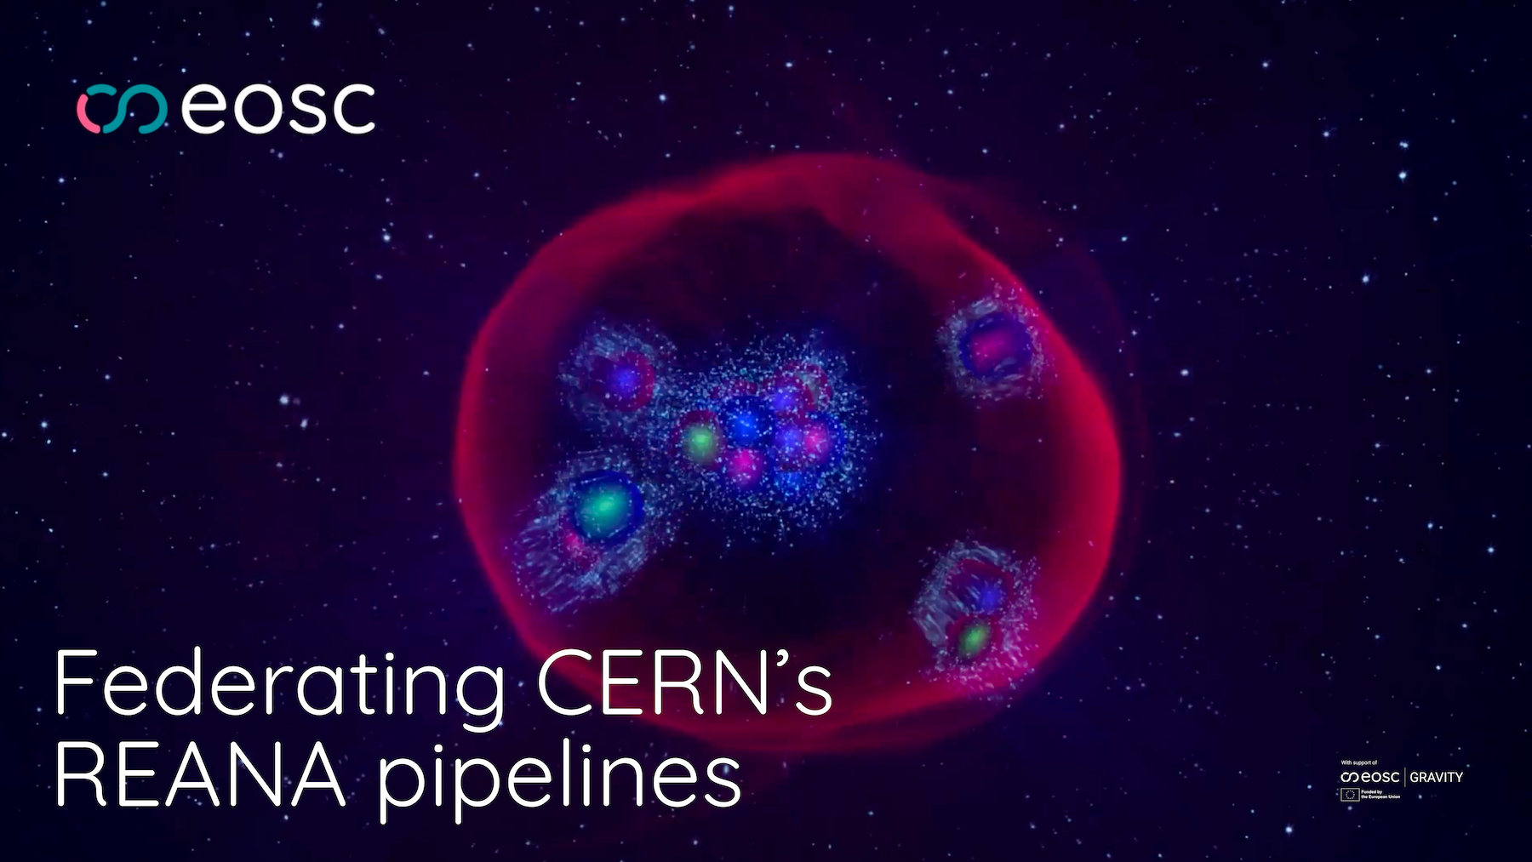
Vast datasets can be made accessible to every researcher in Europe.
EOSC brings compute power to the data.
eosc.eu
Watch the EOSC Federation use case video
Notes:
Link to use case on eosc.eu: https://eosc.eu/news/eosc-federation-use-case-federating-cerns-reana-pipelines
Link to YouTube video: https://www.youtube.com/watch?v=5HuQWAx4Mwc

