Slide 1
EOSC and its positioning in the EU Policy Landscape
An evolving European ecosystem for data-driven research
Spain EOSC tripartite Event, 2 October 2026
Javier Lopez Albacete
Open Science & Research Infrastructures
DG Research & Innovation
European Commission

Slide 2
European Open Science Cloud (EOSC)
An open, trusted, federation of infrastructures
A pan-European system interconnecting FAIR research data and digital/scientific services and tools across scientific disciplines and countries
Enabling European researchers to store, share, process, analyse, and reuse research digital objects (e.g. data, publications and software)
An evolving ecosystem
Accelerate open science, FAIR data management, and use of digital methods and services
Stimulate collaboration in science and research, new insights and innovations, higher research productivity and improved reproducibility in science
Bringing together the EC, Member States, Associated Countries and the many R&I stakeholders involved in the European Research Area - co-created across European, national, and institutional levels

Slide 3
EOSC: an EU policy priority
European Research Area
Policy agenda 2025-27: Structural action Open Science, data sharing & EOSC​
Expected outcomes:​
develop a high-value EOSC Federation and increase its uptake​
increase the amount and productivity of FAIR research data in Europe​
identify areas for measures and initiatives to enable an EU copyright and data framework fit for research​
assess the impact of open science policies and practices based on an open science policy intelligence platform

Slide 4

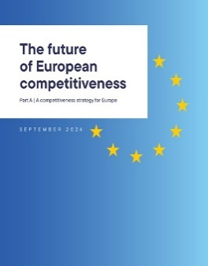
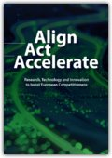
EOSC in recent EU strategies
Letta​
Draghi​
Heitor et al.​
European Strategy on Research & Technology Infrastructures – September 2025
              Sustain and enhance the EOSC Federation as Europe’s research and innovation data space, enabling sharing and reuse of high-quality, FAIR research data, scientific results and digital services.
              Support compliance with FAIR principles, increasing FAIR data productivity, and connections to EOSC and other relevant data spaces.
              Support the pooling and development of AI-ready research data as well as tools and services that enable the development of scientific AI models, and their technological applications, accelerating the use of AI in science and, through it, contributing to the pilot phase of RAISE.
AI Continent Action Plan – April 2025
AI in Science Strategy – October 2025
  RAISE (the Resource for AI Science in Europe) will work closely with EOSC, as well as the other Data Spaces, to make high-quality AI-ready data available for AI science.
  The Commission will support the design of Data Labs and their linking with Common European Data Spaces, in particular EOSC, to ensure their suitability for scientific research.
Data Union Strategy – November 2025​
Data Labs (…) give companies and researchers secure, practical access to high-quality datasets, the support they need to ensure compliance with EU rules, and offer tools, guidance, and trusted environments for data pooling, curation, labelling and pseudonymisation.

Slide 5
EOSC: A joint initiative at EU, national and community levels
Resource mobilisation and HE funding security
Strategic R&I Agenda
Community input for EOSC in Horizon Europe
Advice; national coordination
Position on EOSC in FP10
Policy opinions
Financial estimates for EOSC post-27
EOSC Open Science Observatory
Strategic Steer to Federation build-up
EOSC Federation Handbook
EOSC post-2027
ESFRI-EOSC TF
EC
EOSC A
EC
EOSC A
EOSC A
Steering Board
Member States & associated c.
EOSC Association
Steering Board
EOSC
Tripartite Governance
Steering Board
EC
Steering Board
EOSC
Steering Board
European Commission
EOSC Partnership
EC
Steering Board
EC
Steering Board
EOSC A
EC
Steering Board
EOSC A
EC
Steering Board
EOSC A
EC
Steering Board
ESFRI
EOSC A

Slide 6
Horizon Europe support to EOSC
Around €500 million under EOSC European co-programmed Partnership
2021 - 2025
2026 - 2027
    47 grants + 1 procurement (EU Node)
    4 topics
      26- Uptake of FAIR data management practices and of EOSC by research communities and research infrastructures
      26- Trusted frameworks for secure and efficient data sharing in EOSC
      27- Expanding and deepening the EOSC Federation (Co-fund)
      27- Strengthening the potential of the EOSC for knowledge valorisation and industry academia collaboration
    1 procurement (EU Node extension)
 | EU-contribution | # Grants | Participations | Unique participations
ALL | 331 M€ | 47 | 1006 | 439
SPAIN | 23 M€ (7%) | 31 | 77 | 38
New! Amendment to HE 2026-27 WP, including:
Targeted actions on data sovereignty in the life sciences, biodiversity- health interface, ocean observing and climate projections (EU contribution 140 Meuro)

Slide 7
Expanding & deepening the EOSC Federation
HORIZON-INFRA-2027-01-EOSC-01
Opens 9 March 2027 / closes 15 June 2027
EUR 40 million indicative EU contribution
1 expected project (does not preclude submission and selection of a proposal requesting different amounts)
Programme Co-fund Action
Beneficiaries may provide financial support to third parties. The support to third parties can only be provided in the form of grants.
Maximum amount to be granted to each third party is EUR 2.00 million.
Funding rate is 50% of the eligible costs.
At least 20% of the total financial support to third parties must be open to entities eligible for funding as described in the General Annex B, therefore it must not have any additional geographic restrictions for eligibility for funding

Slide 8
Expanding & deepening the EOSC Federation
HORIZON-INFRA-2027-01-EOSC-01
Expected outcomes:
The EOSC Federation provides to EOSC users with state-of-the-art digital services addressing their needs to store, process and share data, run software, models and workflows, and collaborate with their peers.
Research and digital infrastructures and other organisations providing scientific services are equipped with appropriate structures and technical, legal and coordination mechanisms to onboard, manage and sustainably operate digital tools and services in the EOSC Federation.
Investments across Europe in the provision of FAIR scientific data and services within EOSC are more aligned and coordinated, achieving economies of scale and more efficient use of digital resources.

Slide 9
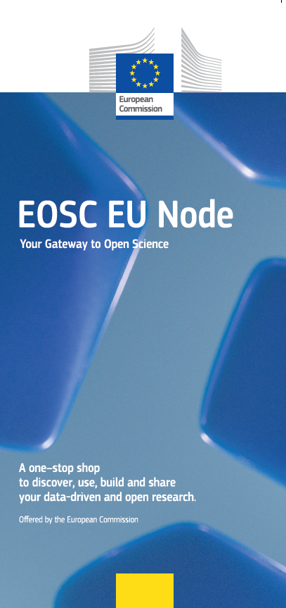
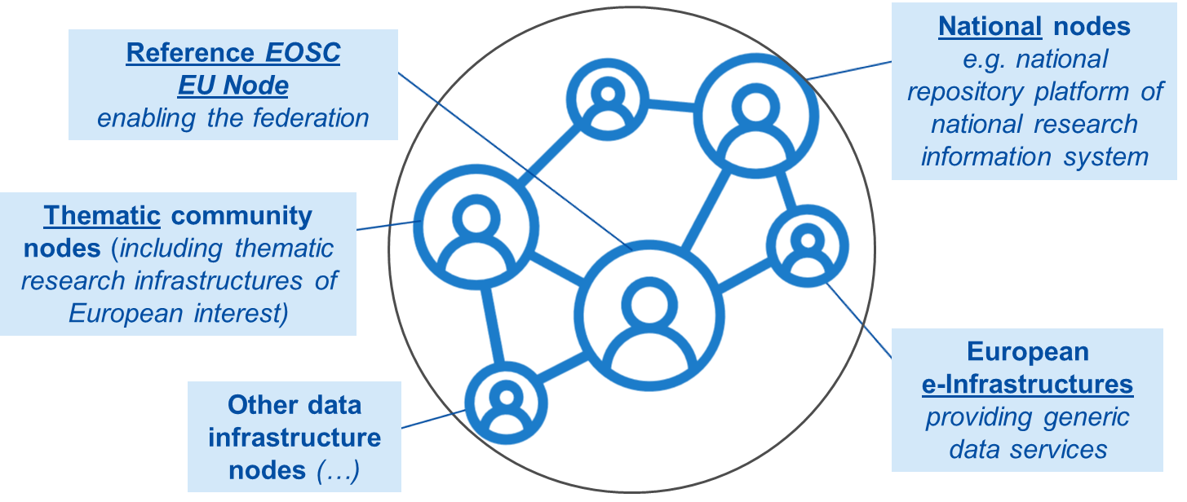

EOSC EU Node
Europe’s trusted entry point to the European Open Science Cloud (EOSC)
Access high-value FAIR European research data, services, and infrastructure resources (e.g., EuroHPC Federation, AI Factories, Research Infrastructures)
Enables cross-border, cross-discipline scientific collaboration at scale
Built on interoperability, sovereignty, trust, and open science principles
Core node of the EOSC Federation
50k+ visitors, 6400+ users
185M+ research products
13 nodes offering 70+ services
JRC users enabled
EOSC EU Node
DG CNECT
Ongoing: EOSC procurement “Managed services for the EOSC Platform (EOSC EU Node)” – to takeover and ensure the incremental improvement and continuous operation, maintenance and support of the integrated suite of managed services that constitute the EOSC EU Node platform in production, as a service owned by the EC.

Slide 10
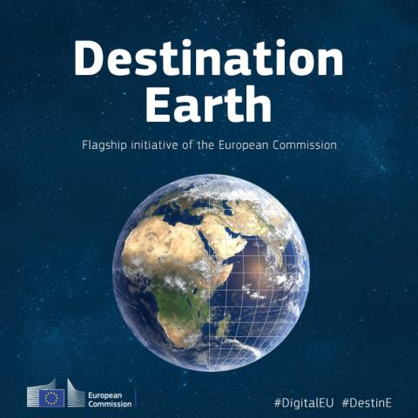






EOSC EU Node’s roadmap
Minimum Viable Product 2026
https://open-science-cloud.ec.europa.eu/
EOSC EU NODE
Authentication, Authorization and Accounting
User Space - AAI
Simpl Proxy
Data Catalogues
Tools Hub
AI / LLM Models
https://platform.destine.eu/
Jupyter Notebooks
REANA
by CERN
Galaxy
by NFDI
Research and Innovation
Federation
1st and 2nd wave Node Candidates
Self-service API
PSNC Safespring
https://my-eurohpc.eu/
EuroHPC Federation Platform
EU Sovereign Cloud and AI Infrastructure
Procured by the EC…

Slide 11

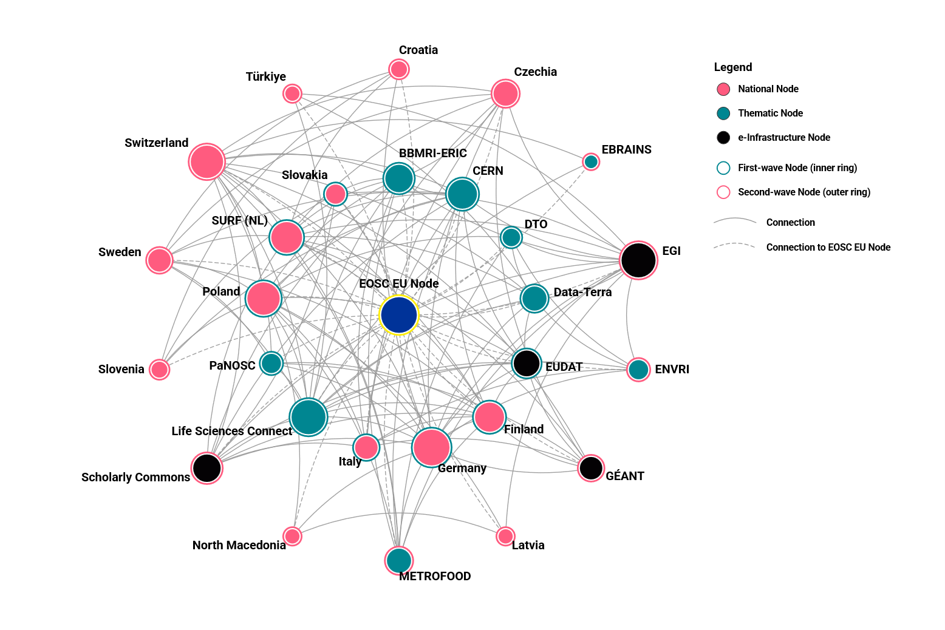
Core Federating Capabilities
Federated AAI
EOSC Catalogue
Helpdesk, Monitoring, Service Management System
Applications, uptake, engagement, …
Storage & compute, VREs, file sync & share, …
Cross-Node scientific use cases
Onboarding resources (e.g. Gravity FSTP)
EOSC User Forum
EOSC Academy
Count from all Nodes’ project charters
194 services
82
repositories
124
use cases
2 calls
28 EOSC Nodes
>64 organisations
3rd call in 2027
Ref. EOSC Association

Slide 12

Objectives for 2026
Expansion
Enrollment of nodes and onboarding of resources and use-cases
Move the EOSC Federation from prototype to production, addressing also legal, governance, operational and engagement requirements
Transition to production
Operational structure
Evolution of federating capabilities and the interoperability framework

Slide 13
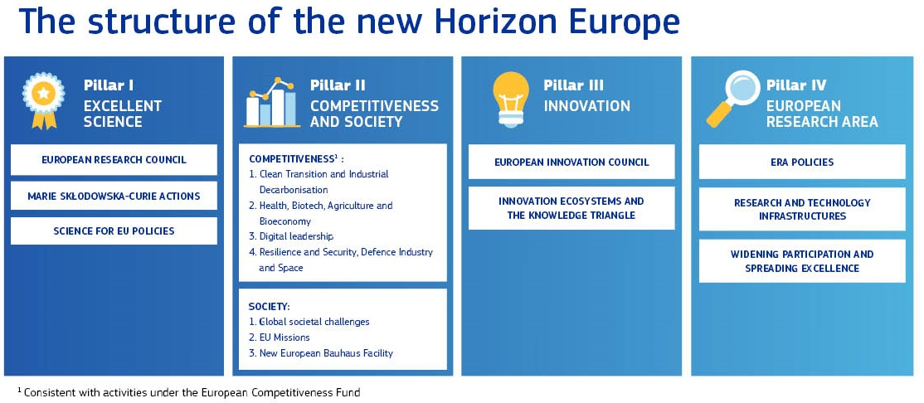
(2028-34)
Horizon Europe total budget EUR 175 billion (current prices)

Slide 14
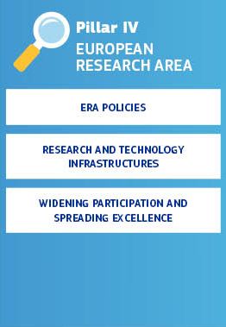
Pillar IV - European Research Area (ERA)
Pillar IV aims to support the development of a unified ERA with a focus on promoting excellence, inclusiveness and impact. It also supports the development and operation of research and technology infrastructures.
Indicative budget: EUR 16.2 billion, of which
EUR 5.4 billion for ‘Widening Participation and Spreading Excellence’

Slide 15
Research and Technology Infrastructures
Research Infrastructures in new HE
Research Infrastructures
Support the construction, development and integration of research infrastructures of EU interest
Developing, consolidating and streamlining the Union landscape of research infrastructures
Reinforcing transnational access to research infrastructures across domains and sectors, and adapting to new emerging user communities
Making research infrastructures more resilient and sustainable while keeping pace with rapid technological advancements
Developing a web of FAIR and machine-actionable research data, including through expanding and consolidating the European Open Science Cloud as Europe’s research data space
Reinforcing European research infrastructure policy and international cooperation
      “Moonshot” projects
      Achieving critical research data sovereignty in Europe: make Europe the world’s most trusted home for critical data for research, giving European researchers, universities, and companies unparalleled competitive advantage in tackling pressing global challenges, from climate change to pandemics.
      …
The funding of the Research and Technology Infrastructures shall contribute to equip the Union with a strong and coherent ecosystem of world-class sustainable facilities and services, building on prioritised pan-European infrastructures and complementary state-of-the-art national capacities and using funding instruments, including European partnerships. The Programme shall contribute up to 20% of the building costs of critical new world-class capacities of European research and technology infrastructures

Slide 16
Towards a model for EOSC after 2027
Operations
Funding
Governance
  How to ensure a science- & user-driven EOSC Federation?
  How to ensure the sustainability of the EOSC Federation?
  …
  How to ensure long-term secure funding?
  How to implement co-funding by the relevant actors (EU, national funders, …)?
  …
  What roles for the different actors (EU, countries, communities)?
  …

Slide 17

Important to align priorities and leverage investments at EU and national levels
Contributions
to EOSC
Member States & Associated Countries
EUR 70 million
per year
EUR 400 million
per year

Slide 18

Thank you
© European Union 2026
Unless otherwise noted the reuse of this presentation is authorised under the CC BY 4.0 license. For any use or reproduction of elements that are not owned by the EU, permission may need to be sought directly from the respective right holders.

Slide 19
Research data sovereignty:
New DRAFT actions under amendment of WP 2026-’27
Targeted actions on data sovereignty in the life sciences
EUR 65 million total EU contribution
UniProt
Protein sequence and function knowledgebase
EU grant will:
Europe PMC
Open-access biomedical literature platform
Ensure uninterrupted & up-to date open science resource for biomedical research literature
Supporting the long-term resilience and European sovereignty of critical research data & knowledge repositories
Budget: €30 million (GIB)
GENCODE
Human and mouse gene/transcript reference
EU grant will:
Budget: €19 million (GIB)
Boost mid/ long-term sustainability
Budget: €8 million (GIB)
EU grant will:
Safeguard EU strategic autonomy by ensuring uninterrupted access to protein data
Boost mid/ long-term sustainability
Safeguard EU strategic autonomy by ensuring uninterrupted access to genomic data
Boost mid/ long-term sustainability
Projects should increase resilience and sovereignty of life sciences repositories and services
Ensure European leadership and contribution to international collaboration frameworks
Budget: €8 million (RIA)
D114172/03 - Comitology Register
Notes:
Supporting European leadership and sustainability of critical research data and knowledge repositories for the life sciences is a package of of 4 topics under the Horizon Europe Horizontal call, bridging actions, promoting data sovereignty measures, and strengthening Europe’s lead in safeguarding critical databases, while ensuring the European Commission’s flexibility to respond to urgent challenges. This package offers a unique opportunity to save critical databases that are endangered by emerging geopolitical funding risks and shifts in international policy agendas. Intended to address challenges in life sciences domains, the budget envisioned for this package is €65 million.
Specifically targeting the life sciences domain, this package ensures funding for the operation and maintenance of databases such as GENCODE and UniProt, essential resources for genomic research and protein sequences. Moreover, the package addresses the further development of technical capabilities of Europe PMC to support an autonomous, uninterrupted repository with reduced dependencies from the NIH-funded Central PMC. In order to address sustainability and resilience measures, a fourth topic was proposed under the same package to support the better integration of critical databases and literature repositories in the federated EOSC ecosystem and across the European Research Infrastructures landscape.

Slide 20
Research data sovereignty:
New DRAFT actions under amendment of WP 2026-’27
Targeted actions on data sovereignty in the biodiversity- health interface, ocean observing and climate projections
EUR 75 million total EU contribution
Advancing interdisciplinary, data-driven research at the biodiversity- health interface under a One Health approach
A stronger Global Ocean Observing System to enhance Europe’s strategic autonomy, climate resilience & biodiversity conservation
Ensure access to FAIR data and digital infrastructures, in view of data sovereignty
Support life sciences – environmental cross-discipline research, enabled through EOSC
Budget: €20 million (RIA)
Increase EU leadership and strategic autonomy in global ocean observation capabilities
Capacity building to advance ocean research, protect and restore ocean health and biodiversity and provide critical services through a global ocean observing system and fit-for purpose, cost efficient data delivery
Budget: €50 million (IA)
Increase EU leadership and strategic autonomy in global ocean observation capabilities
Capacity building to advance ocean research, protect and restore ocean health and biodiversity and provide critical services through a global ocean observing system and fit-for purpose, cost efficient data delivery
Budget: €50 million (IA)
Sustainability and resilience of climate projections & related data records for European and global science and policy
Resilience of the Earth System Grid Federation (ESGF) is strengthened
Foster interoperabiltiy with EOSC
Budget: €5 million (CSA)
D114172/03 - Comitology Register

