Slide 1
Status of the EOSC federation build-up
Klaus Tochtermann, EOSC-A
2 October 2026
With support from Bob Jones

Slide 2
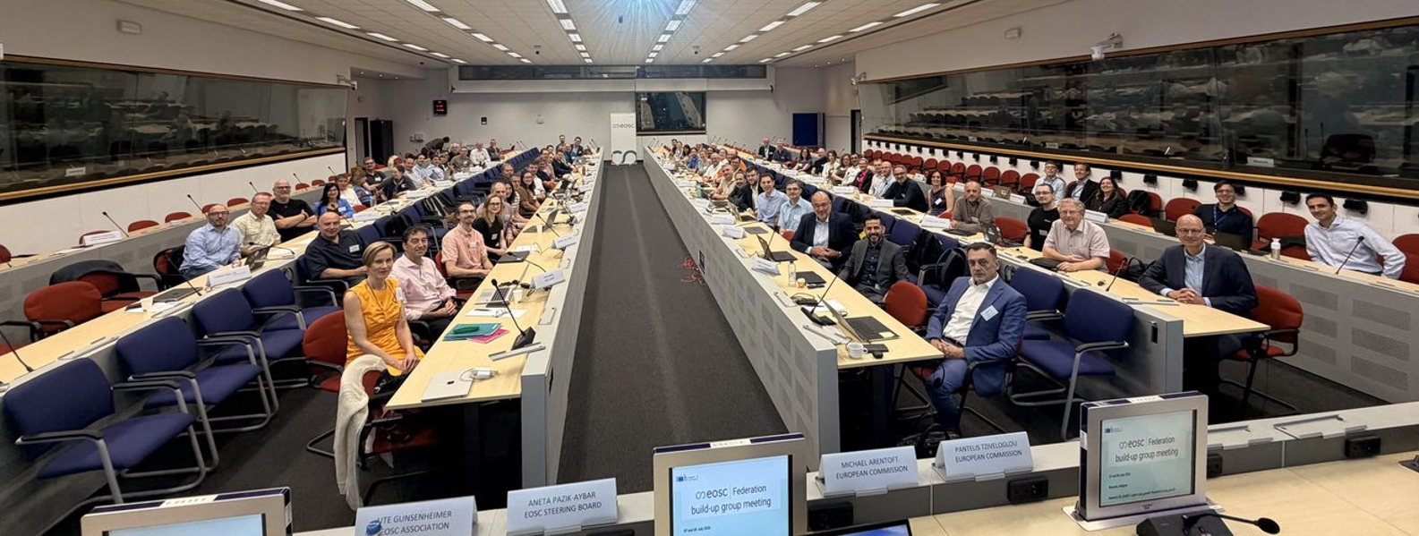
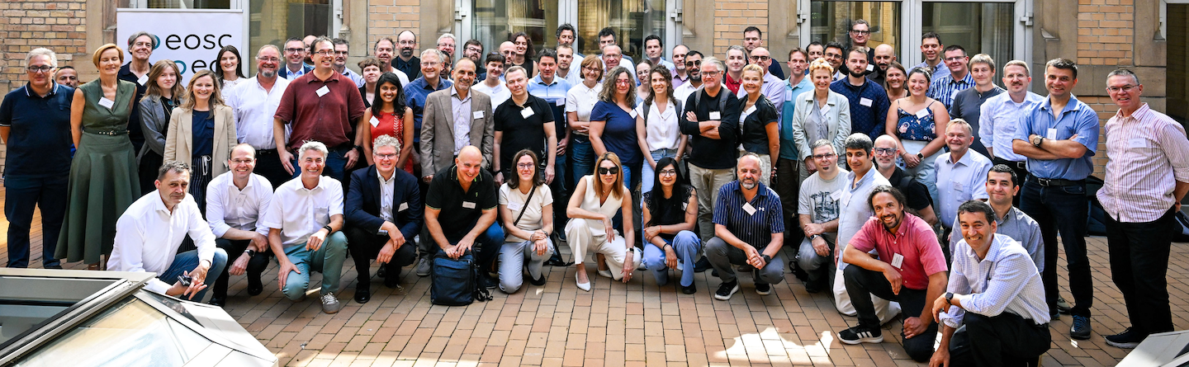
Recent EOSC Federation Build Up Group Meetings
Brussels 7-8 July’26
Hosted by EC
Karlsruhe 8-9 Sept’26
Hosted by EUDAT and NFDI Nodes

Slide 3
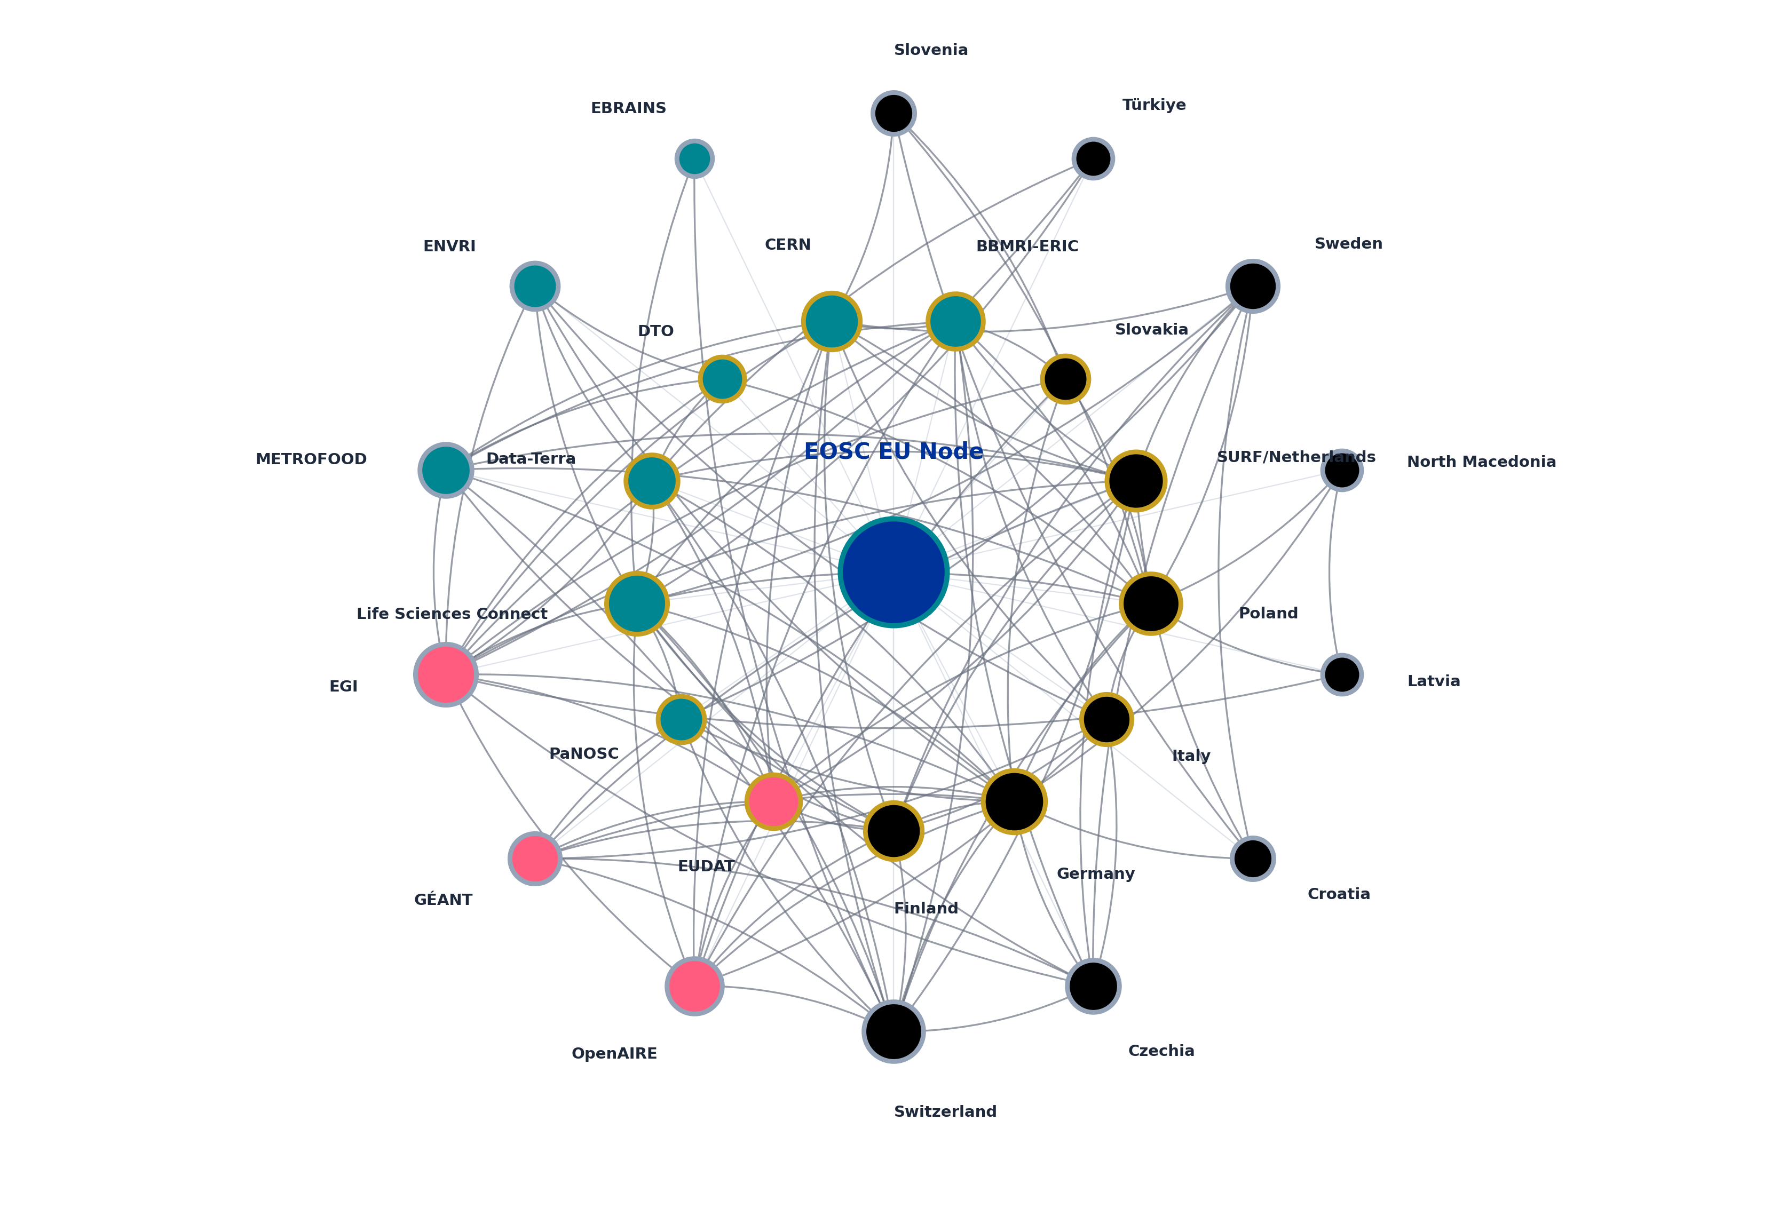
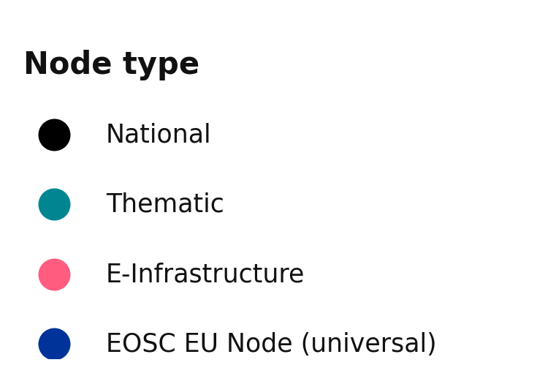
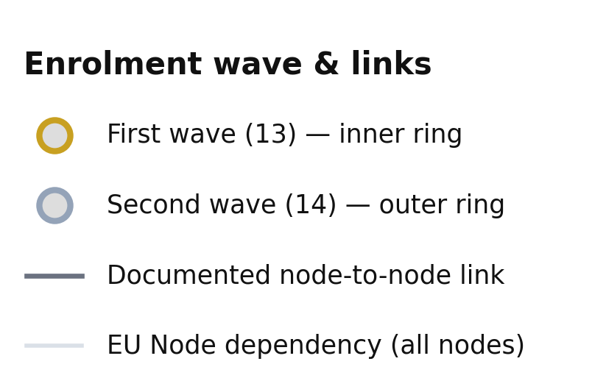
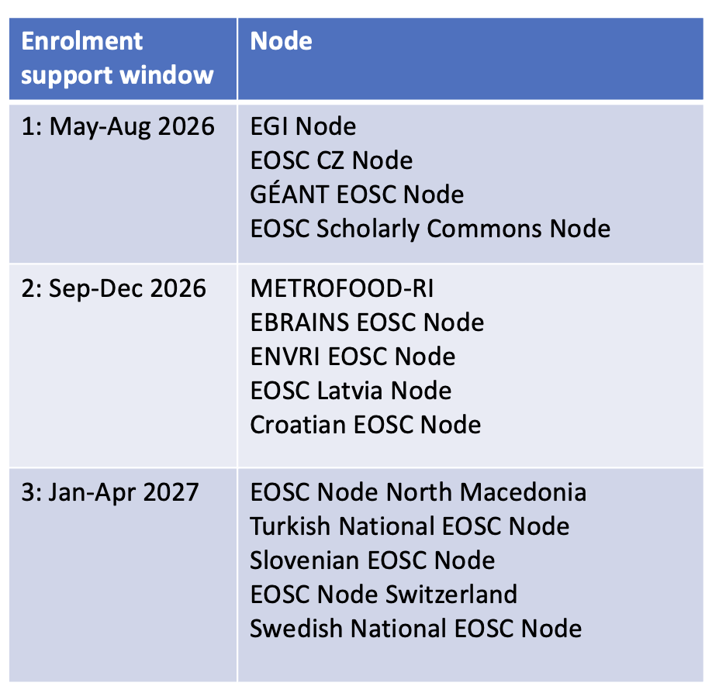
EOSC Federation — Node Interaction Map
Documented cross-node collaborations mined directly from the nodes' latest project charters, coloured by node type; EOSC EU Node shown as universal dependency
Notes:
The inter-node connections have significantly increased.

Slide 4
Node Operations Committee
Co-Chairs: Aastha Mathur (LSC), Roksana Wilk (Poland),
Massimiliano Assante (European DTO),
Secretariat: Neringa Jackevice (EOSC-A)
Node Coordinators Committee
Chair: Bob Jones (EOSC-A), Co-Chair: Matteo Zanaroli (ICSC),
Secretariat: Paola Ronzino (EOSC-A)
Controlled Vocabs approved by NCC
Framework Agreement being finalised
Operations
Capabilities
Governance
Architecture &
Federating Policies
Co-Chairs: Peter Maccallum (LSC),
Giacinto Donvito (Italy), Tommi Suominen (Finland),
Secretariat: Laurence Desnos (EOSC-A)
File Sync & Share
Chair: Ron Trompert (SURF),
Secretariat: Claudia de Visser (SURF)
Legal & Governance
Co-Chairs: Vera Herkommer (LSC), Jos van Wezel (EUDAT), Secretariat: Maja Dolinar (EOSC United)
Federated Authentication and Authorisation Infrastructure (AAI
Co-Chairs: Christos Kanellopoulos (EU Node),
Peter Lényi (BBMRI-ERIC),
Secretariat: Laurence Desnos (EOSC-A)
Virtual Research Environments*
Cybersecurity
Chair: Urpo Kaila (Finland),
Secretariat: Brina Klemencic (EOSC-A)
Approved
Federated EOSC Node
Resource Catalogues
Co-Chairs: Jessica Parland-von Essen (Finland),
Paolo Manghi (EU Node), Andreas Turk (BBMRI),
Secretariat: Lassi Lager (Finland)
Federated Compute
and Storage
Handbook
Chair: Andy Gotz (PaNOSC),
Secretariat: Miguel Rey-Mazon (EOSC Gravity)
WG formed
Training & Competencies
Co-Chairs: Oliver Knodel (PaNOSC),
Magdalena Szuflita-Żurawska (Poland),
Secretariat: Yann Libaers (EOSC-A)
Help Desk
Pavel Weber (KIT, EGI Node)
Requirements need agreement
Preparing V3
Service Monitoring*
Scientific Repositories*
*Working group not yet endorsed by the Node Coordinators Committee
Notes:
NCC & NOC are already active
NCC has formalised the decision-making process via Rules of Procedure
Legal & Gov WG is drafting the legal framework necessary for production operation.
Arch & fed policies WG still getting up to speed. Needs nominated representatives from more nodes.

Slide 5
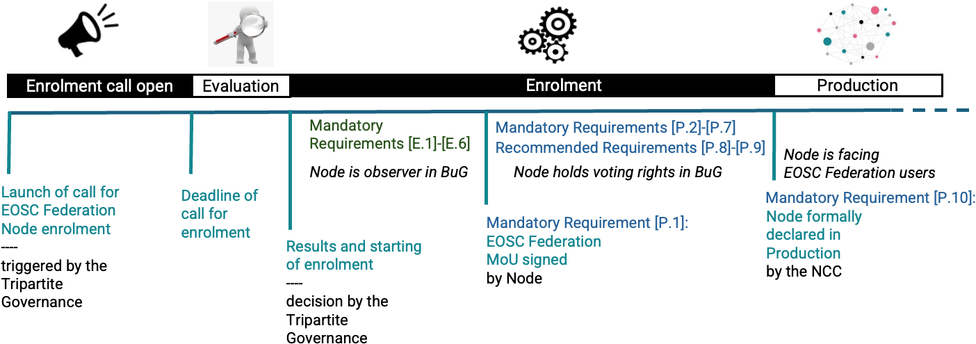
Transitioning to Production for EOSC Nodes
ENROLLED EOSC
NODE
PRODUCTION EOSC
NODE
Production Phase
Initial Enrolment Phase
Second part of the Enrolment Phase

Slide 6
Summary of requirements for an EOSC Federation Node to transition to Production
ID | Requirement | Type | Verified by
E.1 | Node selected through the Tripartite enrolment process | Mandatory | Tripartite Governance / EOSC-A
E.2 | Node dedicated page published on eosc.eu | Mandatory | EOSC-A
E.3 | Node project charter updated | Mandatory | EOSC-A
E.4 | Observer delegates communicated to the BuG bodies | Mandatory | EOSC-A
E.5 | Node Infrastructure Proxy in the AAI acceptance environment | Mandatory | EEN Onboarding Team
E.6 | Use cases from the project charter documented | Mandatory | EOSC-A
ID | Requirement | Type | Verified by
P.1 | EOSC Federation MoU signed | Mandatory | EOSC-A
P.2 | Node Infrastructure Proxy in the AAI production environment | Mandatory | EEN Onboarding Team
P.3 | Node registered in the EEN Node Registry; at least one Catalogue published | Mandatory | EEN Onboarding Team
P.4 | Node Exchange resources available to EOSC end-users | Mandatory | EOSC Nodes, EOSC-A, EEN Onboarding Team
P.5 | Node helpdesk service in place | Mandatory | Helpdesk WG secretary
P.6 | Node Cybersecurity Officer nominated and participating | Mandatory | Cybersecurity WG secretary
P.7 | Node Landing Page compliant | Mandatory | EOSC Nodes, EOSC-A; EEN Onboarding Team
P.8 | Node service monitoring available | Recommended | Node Operations Officer to NOC chairs
P.9 | Node Service Management System available | Recommended | Node Operations Officer to NOC chairs
P.10 | Node formally declared to be in Production | Mandatory | Node Coordinators Committee

Slide 7
Production Readiness Meetings
At the meeting in Karlsruhe, the NCC agreed to hold weekly online meetings until the symposium to accelerate the transition to production
Nodes aiming to achieve production status by the Symposium:
  BBMRI, CERN, Czechia, Data Terra, European DTO, EUDAT, EGI, Finland, GEANT, Italy, PaNOSC, Poland, Slovakia
Meeting objective: Review the status of the transition to production and address blocking issues
The online meetings are scheduled for 09:00-10:00 each Thursday

Slide 8
Timeline
Transition to production
Checklist
Reviewed
Monday 21
September
Checklist
Finalised
Thursday 24
September
Production Meeting
Thursday 1
October
Symposium
14-16 October
Assessment
Thursday 8 October
DECISION : First production nodes
Debrief &
Review
November/
December
Production & NCC Meeting
Monday 5 October

Slide 9
Key production questions addressed
How do we define production?
https://docs.google.com/document/d/1p1rhttgMYKuQ6ktF87NPuA2IfzGFpfw6/edit
A description of the requirements for a Node's Landing Page
https://docs.google.com/document/d/1pSljzI7r4IiIU_4pPCs6JZZxmLUEZaeU/edit
What criteria determine if a node has achieved production status?
https://docs.google.com/document/d/15rY1NdsJy1PyQbuU54-TkE6vxGJgSITR/edit
Which nodes are aiming to achieve production status by the Symposium?
  Symposium: BBMRI, CERN, Czechia, Data Terra, European DTO, EUDAT, EGI, Finland, GEANT, Italy, PaNOSC, Poland, Slovakia
What message to promote at the EOSC Symposium?
  We have achieved a production federation with multiple nodes and many resources.
  Work continues to expand the scope, solidify operations and improve the user experience

Slide 10

Selected Preparatory Grants
Projects started May’26 and complete Oct’26
National nodes
Thematic nodes
French National EOSC Node
INRIA · France
GRAIL — Grant Reuse & Abandoned Ideas Library
Journal of Trial and Error · Netherlands
Open Science · unexecuted research
EOSC-ES-Prep
IACS · Spain
MATSCI-NASU
Bogolyubov Institute, NASU · Ukraine
Materials science
Bulgarian Open Science Portal (BPOS)
NACID · Bulgaria
MatOSC — EOSC Materials Node
UKRI / STFC · United Kingdom
Materials science
UK EOSC National Node Scoping
Jisc · United Kingdom
EOSC-CSN Citizen Science Node
Fundación Ibercivis · Spain
Citizen science (cross-disciplinary)
Enrolling EOSC Ireland
Asiera Technology Services · Ireland
os-ERIN
Wageningen University & Research · Netherlands
Research integrity
Towards an Austrian EOSC Node
ACONET / EOSC Support Office Austria
OPEN-ARK
University of Ljubljana · Slovenia
Design and spatial research
Danish National EOSC Federation Node
DeiC · Denmark
EuroFIR AISBL
EuroFIR / Premotec GmbH · Belgium
Food and nutrition science
EOSC-EST Estonian National Node
University of Tartu · Estonia
Goal: resulting project charters are potentially submitted to the Tripartite third wave enrollment call in 2027
Other candidate nodes may also submit applications (e.g. HORIZON-INFRA-2025-01-EOSC-01 projects)
Notes:
Split between national and thematic: 7 national nodes and 8 thematic nodes.
Two materials science proposals from different countries and teams — MATSCI-NASU (Ukraine/NASU) and MatOSC (UKRI/STFC).
EuroFIR has significant overlap with the second wave METROFOOD-RI node in the food science domain. The differentiation argument (food composition data specifically vs METROFOOD's broader metrology scope) will need to be clear in any eventual charter.
GRAIL is the most unconventional of the set — a "horizontal" Open Science infrastructure for rejected and abandoned research, rather than a domain-specific or national node
Preparatory grant projects start in May and should complete after 6 months (October 2026) having produced a project charter.
They would then be able to apply to a future Tripartite enrolment call for nodes.

Slide 11
Third wave of EOSC Nodes Enrolment call
Production Checklist to be reviewed by the Build-up Group following the Symposium
  Policy questions concerning access to node resources or cost recovery offers
Aim to agree 3rd wave criteria and schedule at Tripartite meeting in Dublin December 2026

Slide 12
Advantages of becoming an EOSC Federation Node
Connect your services and resources to the Common European Data Space for Research and Innovation.
Discover European resources and make your own resources more visible.
Reuse data, software, computing and other services across borders.
Collaborate with national, thematic and institutional infrastructures.
Shape the emerging EOSC Federation and its standards and services.

Slide 13

Register to attend at

