Slide 1
The European Open Science Cloud
April 2026

Slide 2

The ambition of the European Open Science Cloud, known as EOSC, is to develop a ‘Web of FAIR Data and Services’ for science in Europe. The implementation of EOSC is based on a long-term process of alignment and coordination pursued by the Commission since 2015.
Photo by Conny Schneider on Unsplash

Slide 3
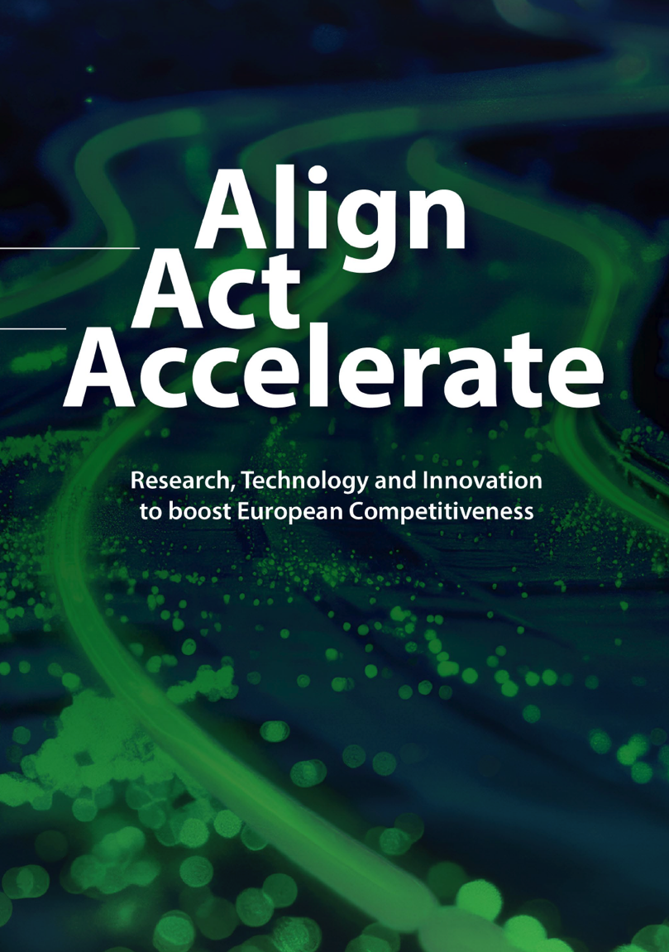
The European Open Science Cloud (EOSC) is a key enabler of the digitalisation of research infrastructures while delivering the European Data Space for research data. It has potential to become the most generally used infrastructure in Europe.
The Heitor report, Commission Expert Group on the Interim Evaluation of Horizon Europe

Slide 4
The EOSC Association
Purpose & benefits

Slide 5
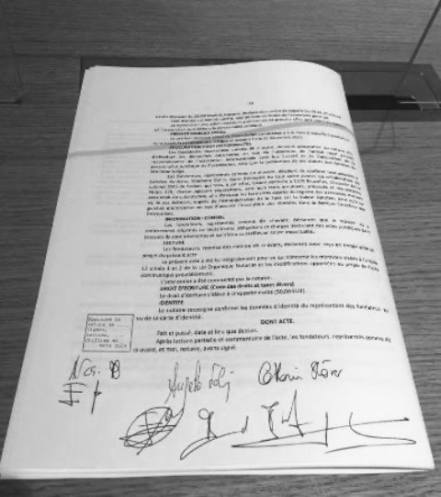
The Purpose of the EOSC Association
Incorporation, 29 July 2020
to provide a single voice for the advocacy and representation of the broader EOSC stakeholder community;
to promote the alignment of European Union research policy and priorities with activities coordinated by the Association;
to enable seamless access to data through interoperable services that address the entire research data life cycle.

Slide 6
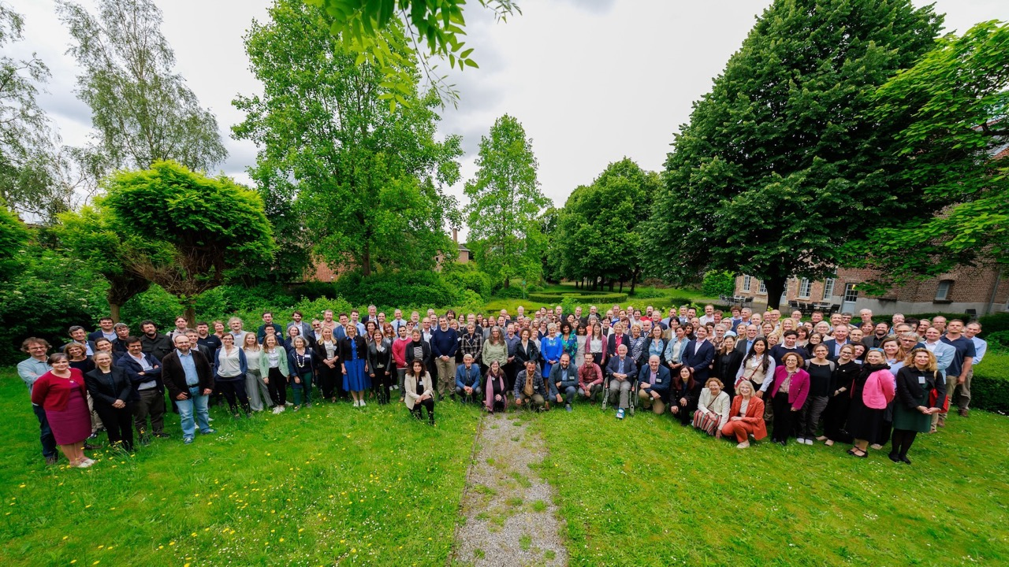

>250
EOSC Association
Members & Observers
The voice of the community

Slide 7

EOSC-A family by membership category
28
= 1 organisation
Mandated Organisations
132
Members
93
Observers
253
Total

Slide 8
Organisations reached indirectly via EOSC-A membership
226
3850
Organisations reached via EOSC-A Members and Observers
Number of institutions in countries where EOSC-A does not have Members and Observers, reached through the individual membership bases of EOSC-A Members and Observers, e.g. Iceland, Liechtenstein, Malta, Tunisia, United States etc.

Slide 9
Reporting structure and internal controls
Secretariat
Board of Directors
Task Forces
Fora
Secretary General
Ute Gunsenheimer
President
Klaus Tochtermann
Mandated Organisations
Technology
Finance & Administration
Marialuisa Lavitrano
Roxanne Wyns
LDTR
Funders
Sara Garavelli
Antje Keppler
Interoperability
RPO Networks
Statutory Auditor (Geert Keunen, VRC)
Communications
Stakeholder Engagement
Suzanne Dumouchel
Enrique Bernal Delgado
Health Data
ESFRI RIs
Monitoring & Reporting
Task Forces Support
Jessica Lindvall
Kamran Naim
FAIR
e-Infras
General Assembly

Slide 10

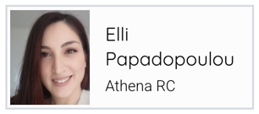
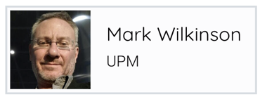
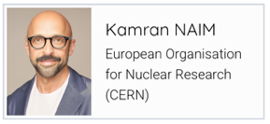


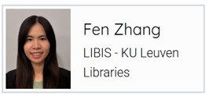
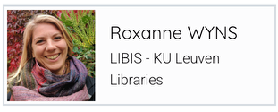

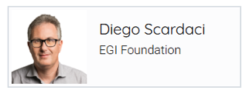

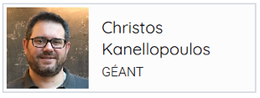
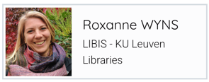

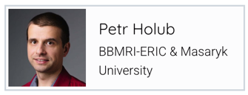
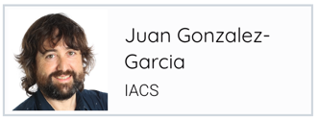

EOSC-A Task Force Co-chairs and Board Liaisons
48 members
28 members
60 members
48 members

Slide 11
The co-programmed EOSC Partnership

Slide 12
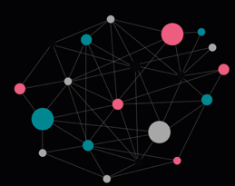
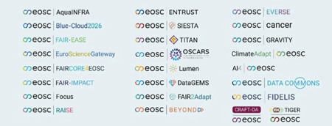
Horizon Europe co-programmed EOSC Partnership
2021 – 2027
EOSC Steering Board
(legeally non-binding) Tripartite Governance
MS/AC
Expert Group of the EC
EU
Partners
EOSC-A
Partnership MoU (non-binding)
3 Objectives
< 490 MEUR EU
< 500 MEUR Inkind EOSC-A
Monitoring+Reporting
Mangement (REA)
CASH
Programme Committee
HE WP
MARs
R&I Activities
National investments in EOSC-related investments
Voluntary collaboration facilitated by EOSC-A

Slide 13
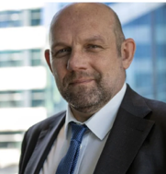

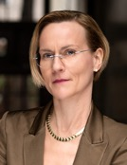
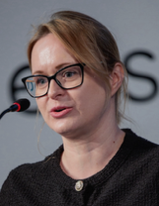
EOSC Tripartite Governance
EOSC is a Co-Programmed Partnership
MoU
Partnership
Board
European Commission
DG-RTD
DG-CNECT
Jean-David Malo
President
Klaus Tochtermann
Secretary General
Ute Gunsenheimer
MS/AC
collective representation
Member States and Associated Countries
Board
General Assembly
EOSC Steering Board
(including organisations performing research, funding research, providing services, organisations mandated by MS/AC and other organisations)
Exchange of information
Aneta Pazik-Aybar
European Commission
EOSC Association

Slide 14
The EOSC Steering Board

Slide 15

EOSC Steering Board
Commission Expert Group
Lead: DG Research and Innovation
Co-chaired between EC and countries’ representatives since 02/2022
42 countries represented: 27 Member States, 15 Associated Countries
The EOSC Association is an observer
Leadership as of February 2026
Aneta Pazik-Aybar
Head of Open Science Team, National Science Centre Poland
More information: https://ec.europa.eu/transparency/expert-groups-register/screen/expert-groups/consult?lang=en&groupID=3756

Slide 16
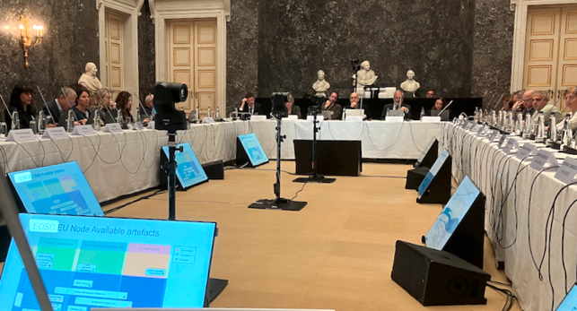
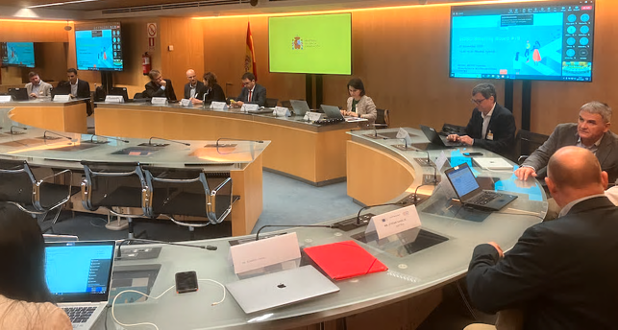
EOSC Steering Board role
Represent the interests of the MS/AC in the EOSC governance
Address policy issues relevant for the development of EOSC
Ensure information flow between EOSC governance and ministries
Interconnect with other relevant initiatives/programmes on EU level
Meet ~6 times per year
Advance work in subgroups (Monitoring, Policies…)

Slide 17
EOSC Steering Group subgroups
Subgroup A: National contributions to EOSC SB
Benchmarking of MS/AC implementation of EOSC-relevant policies on national, regional, or institutional level and their support of EOSC-ready infrastructures and initiatives
Subgroup B: Policy sub-group
Drafts opinion papers to the EOSC-SB on policy issues and/or programmatic synergies (at European, national and/or institutional levels)
Produces an overview of relevant policy issues raised on the occasion of National EOSC tripartite events and advances the policy discussion in the EOSC-SB

Slide 18
The Tripartite Governance

Slide 19



EOSC Tripartite Governance
EOSC Partnership
2021-2030
1 BEUR
EC
(RTD +
CNECT)
EOSC Association
EC Expert Group representatives
of MS/AC
EOSC
Steering Board
Meets twice per year for half a day
Group
Group
European Commission
EOSC-Steering Board Sub-group Policy
EOSC Association Board of Directors
Meets every 2 – 3 weeks for 2 hrs, can appoint external experts

Slide 20
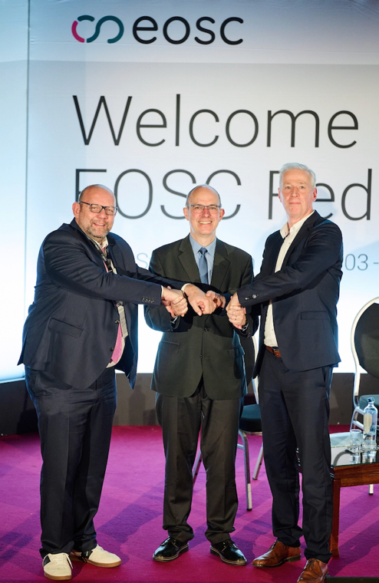
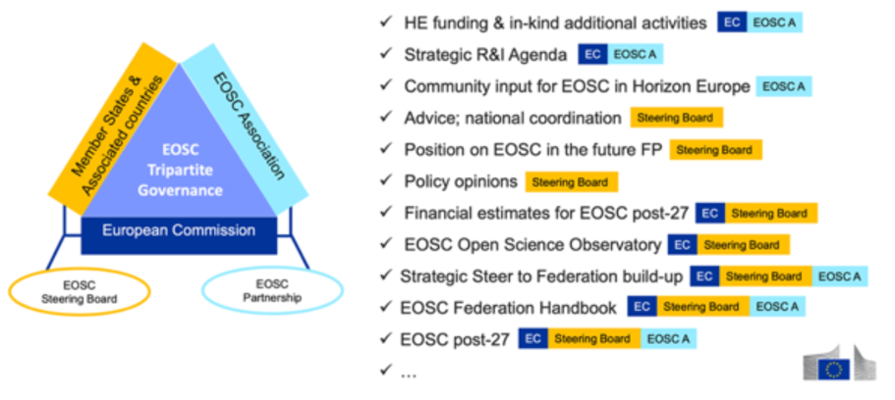
Tripartite Governance
The EOSC Tripartite Governance has become increasingly aligned in its ambitions over the last year, and the governance model for EOSC is proving to be more and more effective.
“Let's act together to complete [the EOSC Federation] fast and make it the backbone of Europe’s digital research and innovation ecosystem. [. . .] You can count on the full support of the European Commission in this vital and transformative endeavour.”
Director-General for DG RTD Marc Lemaître
EOSC Symposium 2025
EOSC as a joint initiative at EU, national, community and levels. DG RTD’s ERA & Innovation Acting Director Jean-David Malo at the EOSC Symposium 2025

Slide 21

Tripartite Group
The EOSC Tripartite Group, made up of the representatives of the three parties to the Tripartite Governance, is working regularly to advance EOSC toward production.
Chair: Michael Arentoft, DG RTD’s Head of Unit for Open Science and Research Infrastructures
Has met monthly in 2025 (10 times) with an 11th meeting scheduled for 11 December 2025
The Group has thoroughly embraced its oversight role for the EOSC Federation
Key objective in 2026: come to agreement on a post-2027 framework for EOSC in the context of the Commission’s proposed MFF 2028-2034 and the next Horizon Europe
Photo by fauxels on Pexels

Slide 22
EOSC and European policies and strategies

Slide 23
EOSC and the EOSC Federation have been called out on several occasions in 2025 as a key structural element for the advancement of European competitiveness in research and innovation.
EOSC in European policies and strategies
European Council’s recommendations on the ERA Policy Agenda: EOSC is reaffirmed as a key element of Priority Area 1: Deepening a truly functioning internal market for knowledge
Strategies for AI in Science and the Data Union: EOSC is identified as a critical enabler of AI in science by providing access to interoperable and reusable datasets
European Strategy on Research and Technology Infrastructures: EC pledges to develop actions in support of “aligning and coordinating investments across Europe for trusted and secure storage, processing and sharing of critical data including through EOSC”

Slide 24
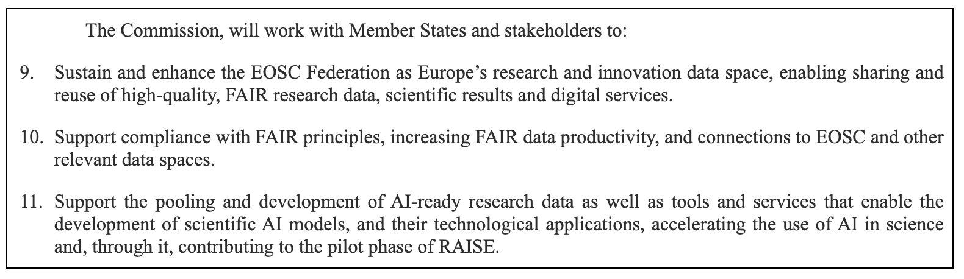
A European strategy on research and technology infrastructures, 15 Sep 2025
Communication from the Commission to the European Parliament, the Council, the European Economic and Social Committee and the Committee of the Regions.

Slide 25
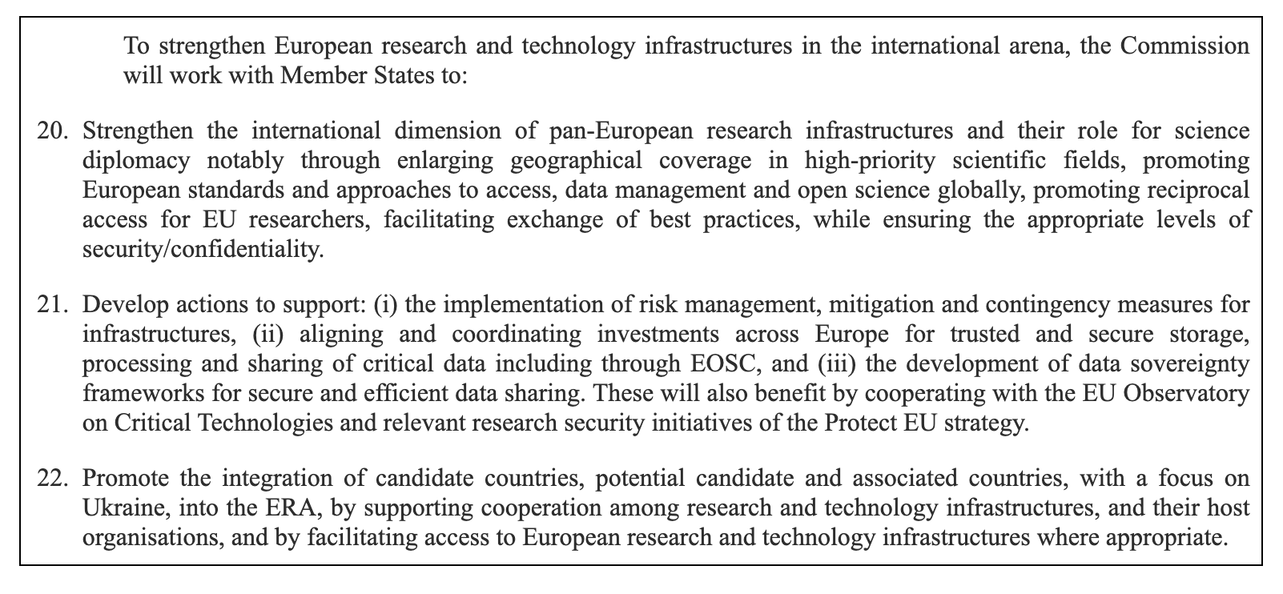
A European strategy on research and technology infrastructures, 15 Sep 2025
Communication from the Commission to the European Parliament, the Council, the European Economic and Social Committee and the Committee of the Regions.

Slide 26
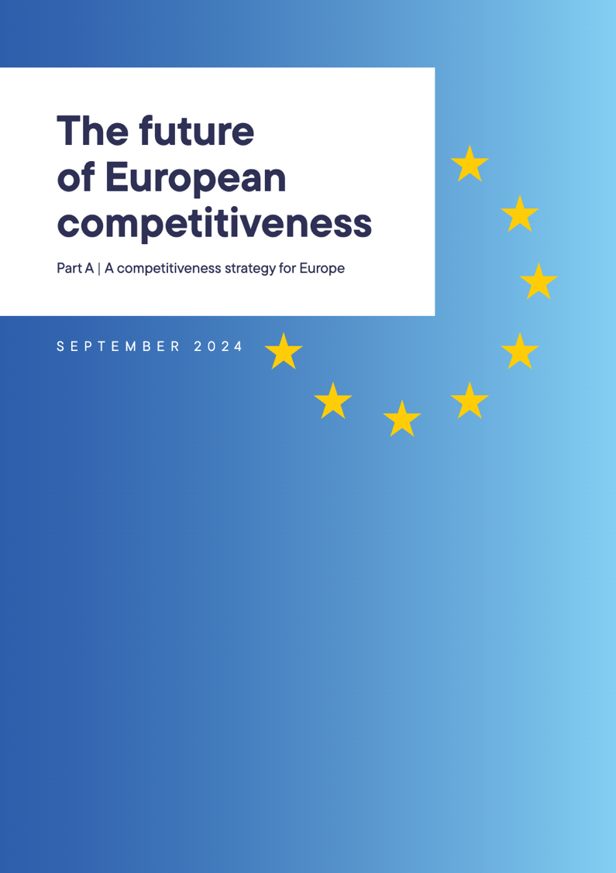
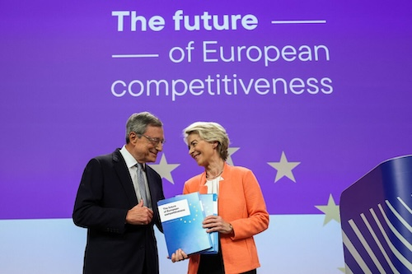
The integrated approach of EOSC responds to need for a strong, cohesive research system to maintain Europe’s competitiveness as highlighted in the Draghi report.

Slide 27


Slide 28
Principles for building the EOSC Federation
The vision for EOSC is to establish a system that enables researchers in Europe to store, share, process, analyse, and reuse FAIR research outputs—such as research data, publications, and software—across disciplines and borders.
System of systems approach: Build on existing and planned infrastructures to create an interconnected ecosystem.
Inclusivity and accessibility: Ensure low barriers to entry, ease of use, and broad participation.
Community-driven and participatory: Engage the research community in co-creating and shaping the Federation.
Trust, security, and governance: Establish clear rules, monitoring, and enforcement mechanisms to ensure a safe and reliable environment.
Flexibility and adaptability: Allow for an evolutionary approach, adapting based on findings and lessons learned.
Autonomy and control: Respect institutional autonomy while ensuring that data and service owners retain full control over shared resources and openness levels.
Broad engagement and transparency: Keep all interested stakeholders informed and involved in key developments.

Slide 29
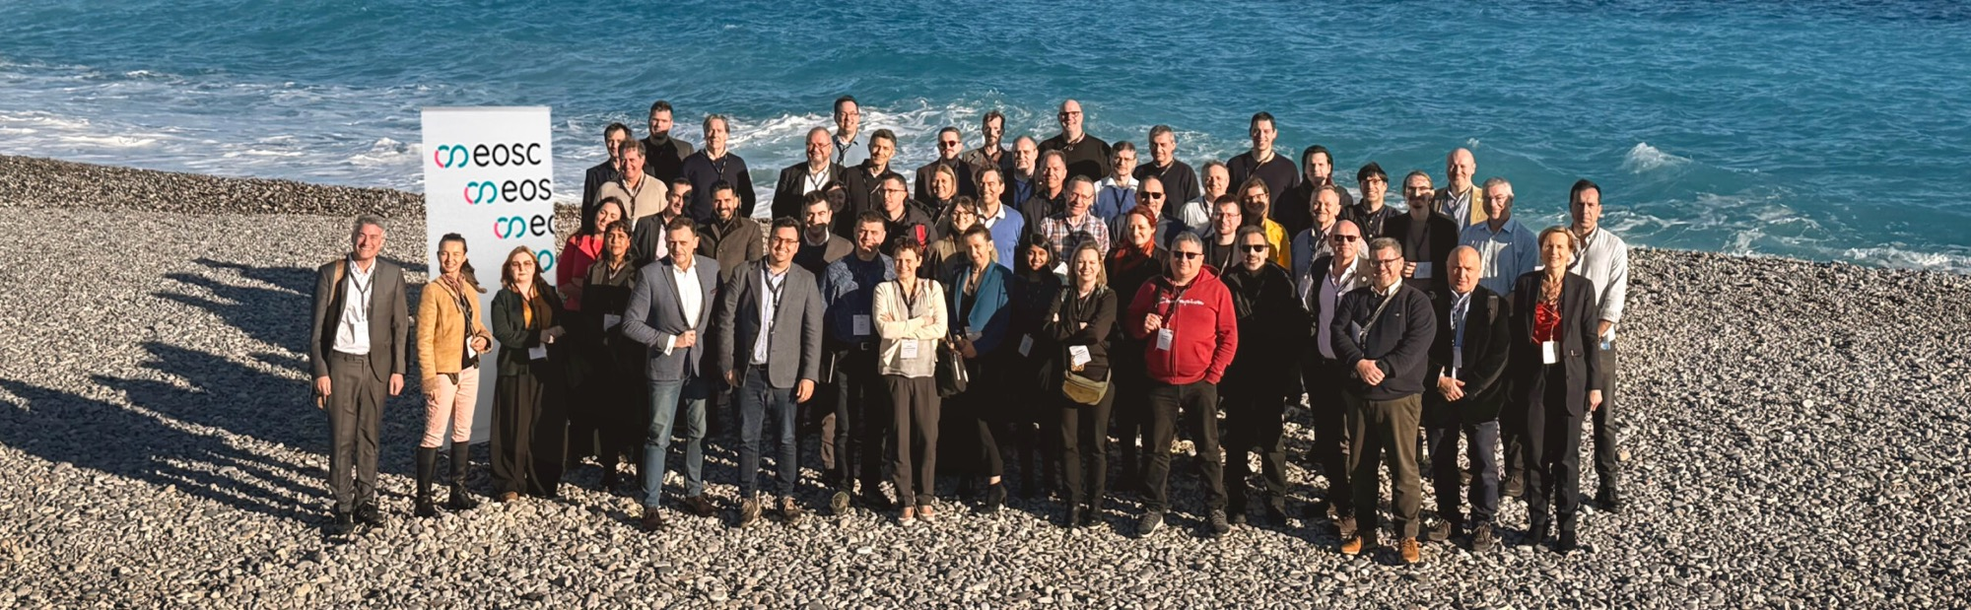
The European Open Science Cloud is quickly moving toward an operational EOSC Federation
The EOSC Federation and the EOSC EU Node are online, with 13 candidate EOSC Nodes in various stages of development
As champions of the European research community, the organisations standing behind the EOSC Nodes, incl. Research Infrastructures, e-Infrastructures, and research-performing organisations, have established the technical and organisational foundations for the future of Open Science in Europe

Slide 30

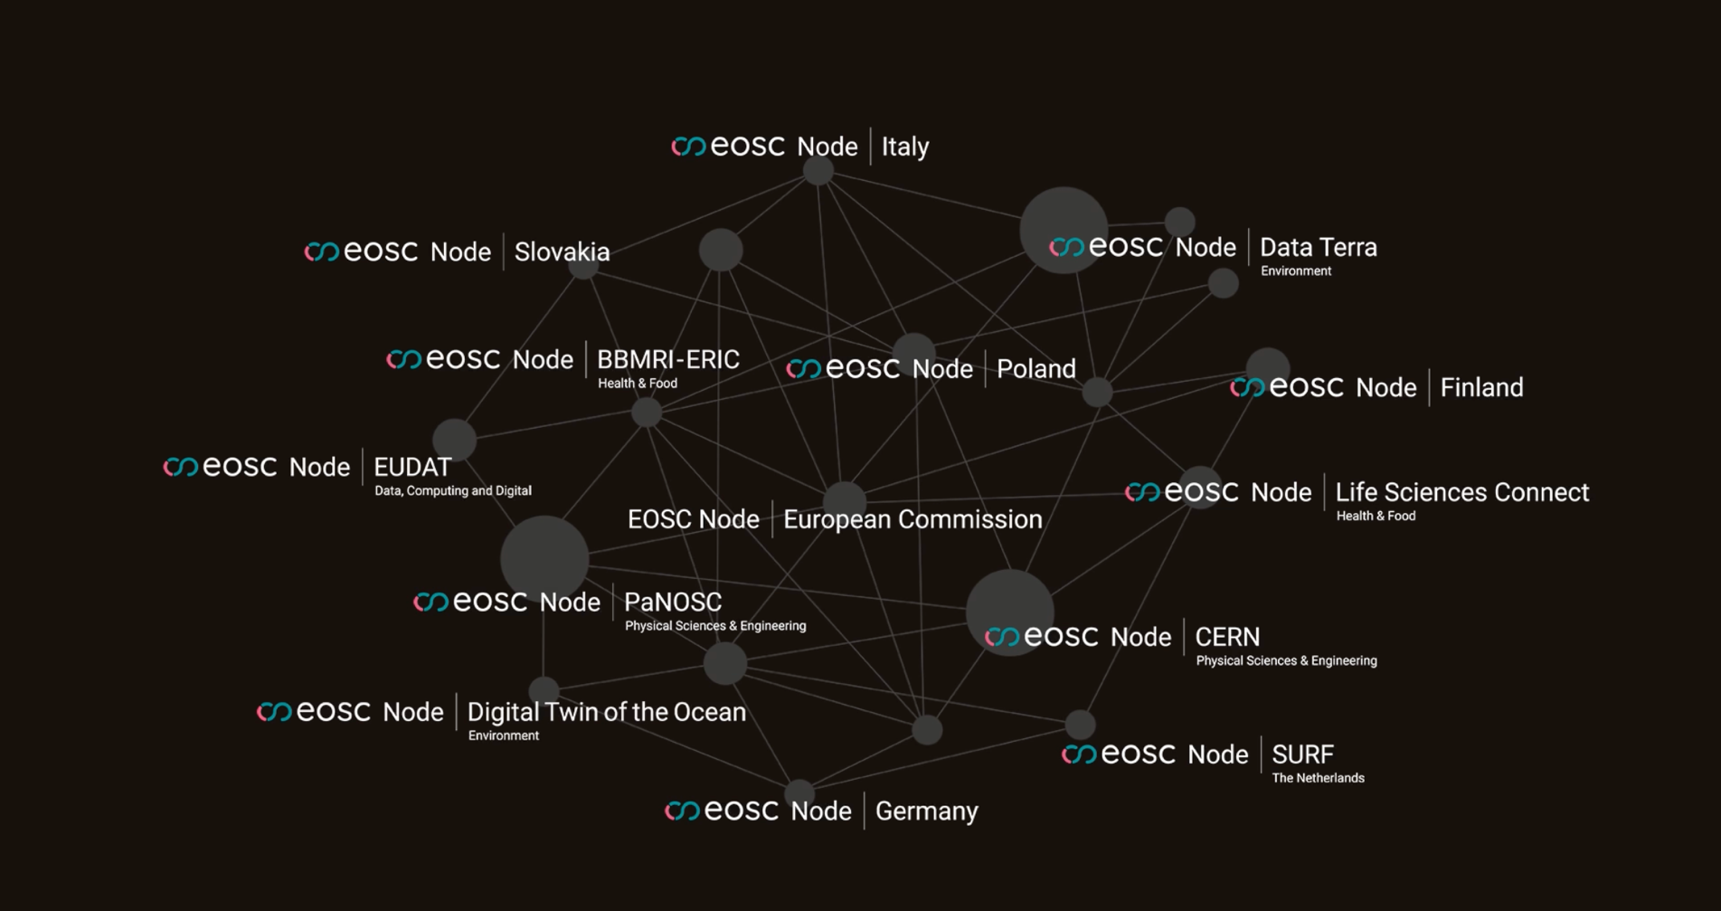
Nodes engaged in 2025: Federating many services and research product catalogues - and growing!

Slide 31
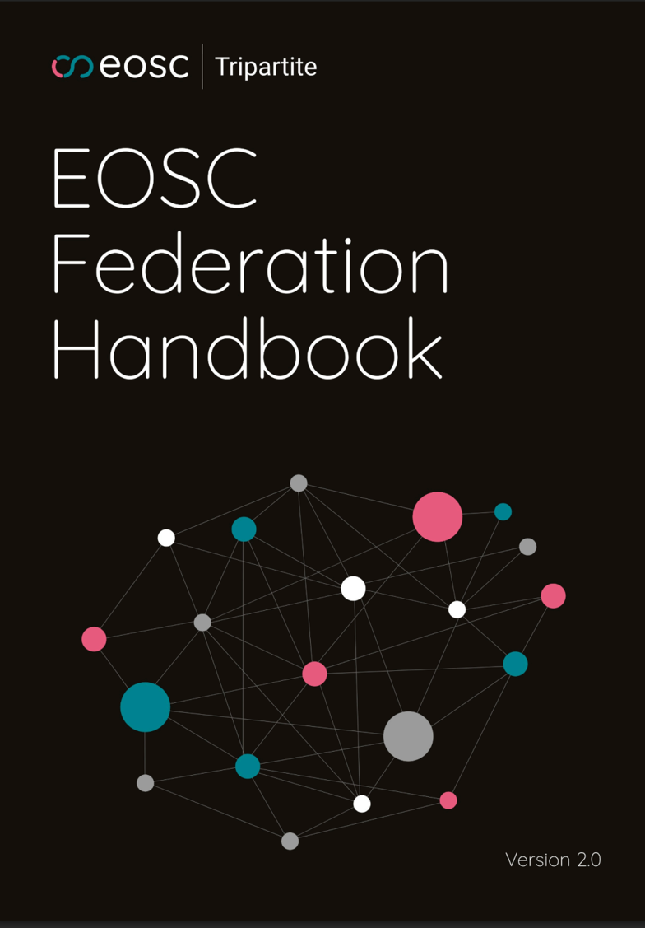
Version 2.0
Serves a hands-on guide for organisations interested in making their resources available through the EOSC Federation
Offers a comprehensive overview of the Federation’s organisational, operation, and technical characteristics
Available on Zenodo, DOI: 10.5281/zenodo.18454649
Handbook sub-group members
Spiros Athanasiou (EU Node), Abdulrahman Azab (EUDAT), Mauro Campanella (ICSC), Natalia Galica (Poland), Jose Benito Gonzalez Lopez (CERN), Andy Götz (PaNOSC), Maarten Hoogerwerf (SURF), Pasquale Pagano (Digital Twin of the Ocean), Jessica Parland-von Essen (Finland), Alessandro Rizzo (Data Terra), Diego Scardaci (EOSC Beyond), Silvia Sofianos (Slovakia), Mark van de Sanden (GÉANT), Jonathan Tedds (Life Sciences Connect), Andreas Türk (BBMRI), Wilma Wolf (NFDI)
Editors
Andy Götz (EOSC-A + ESRF), Rudolf Dimper (EOSC-A), Bob Jones (EOSC-A), Miguel Rey Mazón (TU Graz/EOSC Gravity)

Slide 32
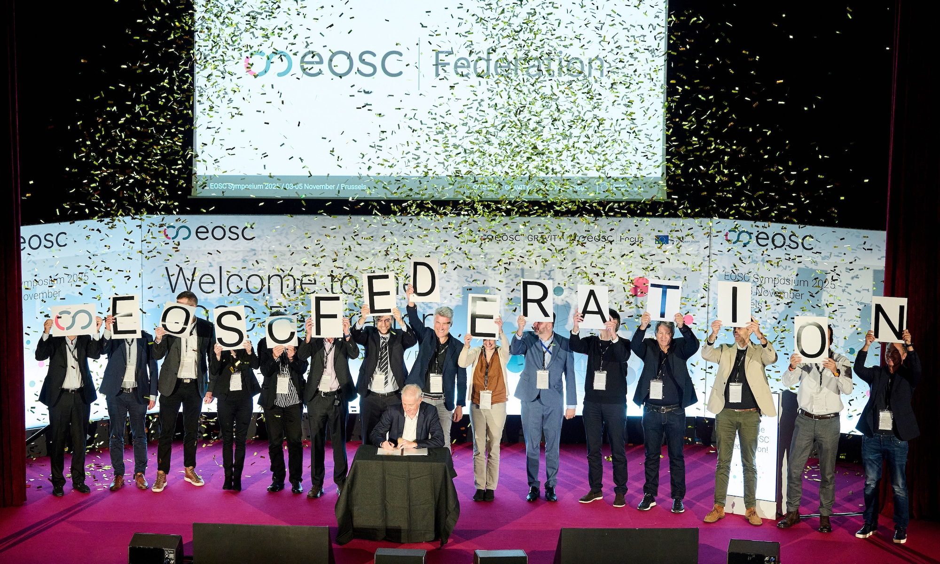

Slide 33
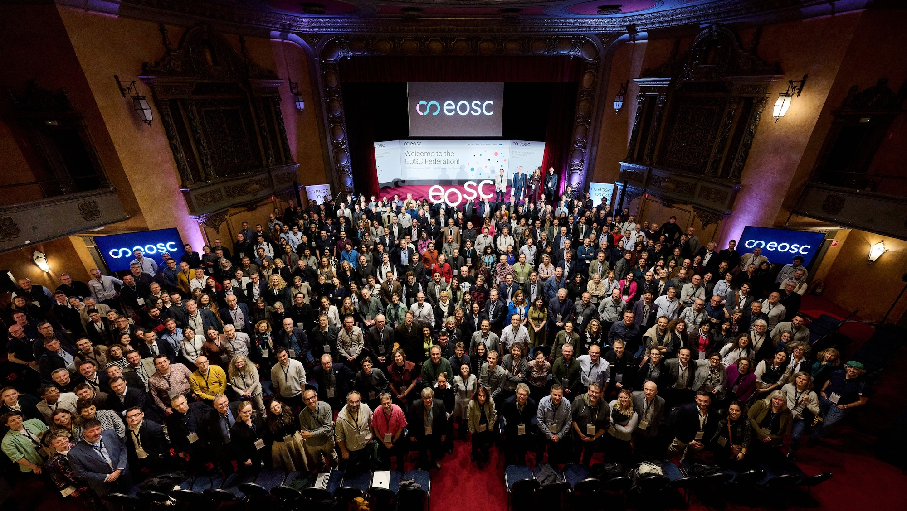
”What matters most is to keep the momentum, the ambition and the shared purpose that have brought us this far. So let’s seize this moment, let’s act together to complete [the EOSC Federation] fast and make it the backbone of Europe’s digital research and innovation ecosystem …. You can count on the full support of the European Commission in this vital and transformative endeavor.”
Marc Lemaître @EOSC Symposium 2025

Slide 34

Objectives for 2026
Operational structure
Migrate Build-up group to the operational structure outlined in the MoU
Move the EOSC Federation from prototype to production
Transition to production
Evolution of federating capabilities and the interoperability framework
Address legal, governance, operational and engagement requirements
Expansion
Enrollment of nodes and onboarding of resources and use-cases
Leveraging wave of enrolment waves, EOSC Gravity cascading grants, HORIZON-INFRA-2025-01-EOSC-01

