Slide 1
These slides showcase seven policy areas in which EOSC features as a strategic priority for the EU to build a trusted, secure and sovereign research data ecosystem.
They describe the ways in which a reinforced European Partnership for the European Open Science Cloud will support the objectives of the European Commission’s proposal for Horizon Europe 2028-2034 (FP10).
You are encouraged to use these slides in your advocacy efforts in support of EOSC, EOSC-A and the EOSC Federation. The content has been approved by the EOSC Tripartite, and we ask that you do not alter it.
The images in these slides are free to use so long as the author credits on each slide remain visible.
For any questions regarding the content or use of the slides, please contact the EOSC-A Secretariat at info@eosc.eu.

Slide 2

EOSC to safeguard European data sovereignty
EOSC ensures long‑term, secure, and trustworthy access to research data in compliance with EU regulations.
eosc.eu
Image by Jorge Franganillo from Pixabay

Slide 3

EOSC to foster European leadership in AI
By unlocking large, diverse, machine‑actionable FAIR datasets, EOSC directly supports AI development and reduces data scarcity. It also ensures interoperability, provenance, and reproducibility, which mitigate “black box” risks and enable responsible AI.
eosc.eu
Image by Gerd Altmann from Pixabay

Slide 4

EOSC to increase security in research & data management
EOSC safeguards sensitive resources while enabling scientific innovation and fostering cross-border, cross-disciplinary collaboration.
eosc.eu
Image by Roman from Pixabay

Slide 5
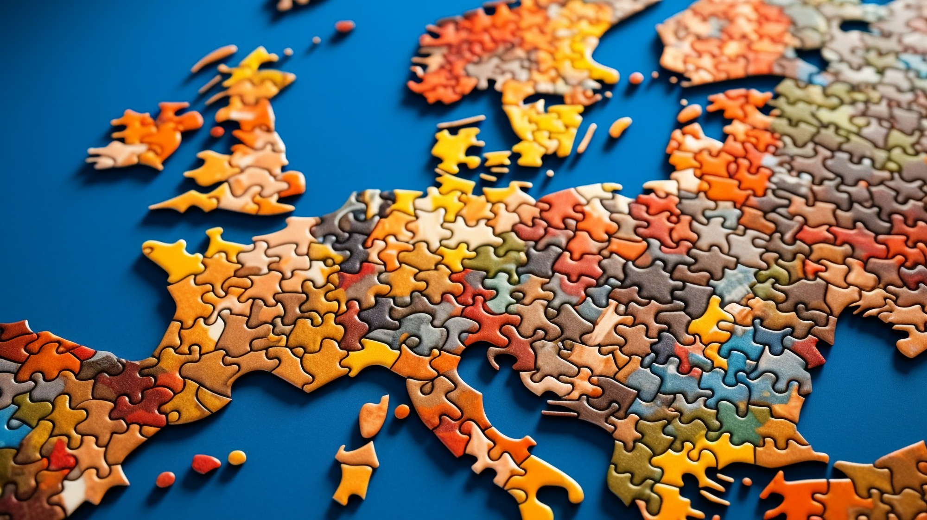
EOSC to establish the EU Single Market
for knowledge
EOSC plays a central role in removing barriers within the European Single Market for knowledge by enabling seamless sharing and reuse of research data across countries, disciplines, and infrastructures.
eosc.eu
Image by Jorge Franganillo from Pixabay

Slide 6

EOSC to enhance Europe’s global scientific competitiveness
By standardising data sharing protocols and ensuring interoperability across disciplines and borders, EOSC facilitates the interdisciplinary collaboration required to address complex global challenges such as climate change, health, etc.
eosc.eu
Image by Gerd Altmann from Pixabay

Slide 7

EOSC to boost European data economy
EOSC enhances Europe’s productivity by transforming fragmented assets into interoperable, high‑value capabilities, reducing costly duplication of efforts and maximising the return on public investments.
eosc.eu
Image by Nattanan Kanchanaprat from Pixabay

Slide 8
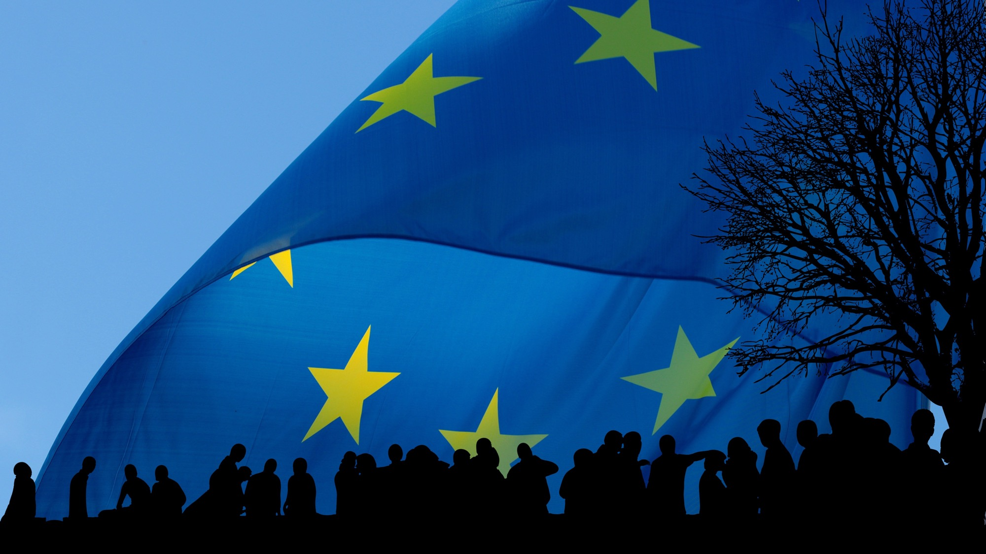
EOSC to empower European values
By providing open access to FAIR datasets, EOSC empowers researchers, educators, and innovators from all regions to engage in cutting-edge scientific work, democratising access to research resources across Europe.
eosc.eu
Image by Gerd Altmann from Pixabay

