Slide 1
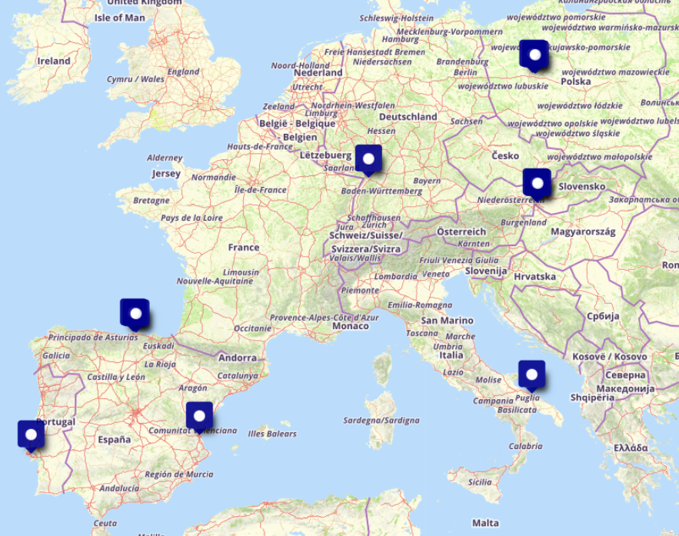
AI4EOSC
Project in a Nutshell
Project name: Artificial Intelligence for the European Open Science Cloud
Advanced set services for the development of AI, ML and DL models and applications in the EOSC. The services will make use of advanced features such as distributed, federated and split learning; provenance metadata; event-driven data processing services or provisioning of AI/ML/DL services based on serverless computing.
Start date: 1 September 2022. End date: 31 August 2025
Coordinator: Spanish National Research Council (CSIC)
Consortium: 7 academic + 2 SME + 1 non-profit

Slide 2
Key Contributions to EOSC SRIA
Contribution of AI4EOSC
Metadata and ontologies
Definition of ML model provenance tracking system, based on PROV-O, domain specific ontologies for specified cases
Explore integration with metadata registries for model provenance
FAIR metrics and certification
Adopting reccomendations of RDA FAIR Data Maturity, piloting for ML community
Extension of FAIR EVA (https://dx.doi.org/10.20350/digitalCSIC/14559) to support ML model provenance
Authentication and authorisation
Adoption of AARC BA for AAI services (i.e. IdP proxy)
User environments
Composability of services through clear and well defined interfaces
Interoperability with community and state of the art tools and platforms
Fostering community of practice around AI/ML in EOSC through collaborative environments and model exchange

Slide 3
Key Contributions to EOSC SRIA
Contribution of AI4EOSC
Resource provider environments
Ease onboarding of providers through orchestration tools (i.e. PaaS Orchestrator)
Automated provisioning of resources into AI4EOSC platform
Multi-tenancy partitioning of resources within a single platform deployment
Self-hosted automated deployment of AI4-based platform
EOSC Interoperability framework
AI services and platforms interoperability guidelines (collaboration with EOSC-Future)
OpenAPI specifications for all services and platform APIs
e.g. https://github.com/AI4EOSC/ai4-papi
Open architecture through C4 model description and arc42 architecture templates
https://github.com/AI4EOSC/ai4-architecture
FAIR-EVA adoption for metadta objects and content of digital objects
Integration with EOSC-enabled repositories for digital assets
Skills & Training
Extensive training and training materials about AI app. development in the EOSC and not only
Widening to public & private sectors & going global
Collaboration witn AIoD
Service uptake, consultancy, etc. through close collaboration with EOSC-DIH

Slide 4
Key impacts and deliverables
AI4EOSC
Increased number of services in the EOSC Exchange
AI/ML generic (AI4EOSC platform) or community specific
Transforming developent of AI models for science in the EOSC
FAIR, reproducibility of pipelines, model provenance
Best practices for development AI and ML models
Improvement of robustness of AI systems -> Trustworthy AI
Drift detection tools and services to assess data/model/inference validity
MLOps infrastructure and services for AI scientists
Provenance of models (reproducibility)
(Main, relevant) Deliverables
AI platform for the EOSC (AI4EOSC platform)
Integrated IDE environments
Advanced ML features: federated learning, homomorphic encription, privacy tools and models
Composite AI, cross discipline pipelines, serverless platforms
Software stack (AI4OS) to build customizez AI platforms
Best-practice documents for the AI community of practice in the EOSC

Slide 5
Key impacts and deliverables
AI4EOSC
Increased number of services in the EOSC Exchange
AI/ML generic (AI4EOSC platform) or community specific
Transforming developent of AI models for science in the EOSC
FAIR, reproducibility of pipelines, model provenance
Best practices for development AI and ML models
Improvement of robustness of AI systems -> Trustworthy AI
Drift detection tools and services to assess data/model/inference validity
MLOps infrastructure and services for AI scientists
Provenance of models (reproducibility)
(Main, relevant) Deliverables
AI platform for the EOSC (AI4EOSC platform)
Integrated IDE environments
Advanced ML features: federated learning, homomorphic encription, privacy tools and models
Composite AI, cross discipline pipelines, serverless platforms
Software stack (AI4OS) to build customizez AI platforms
Best-practice documents for the AI community of practice in the EOSC

Slide 6
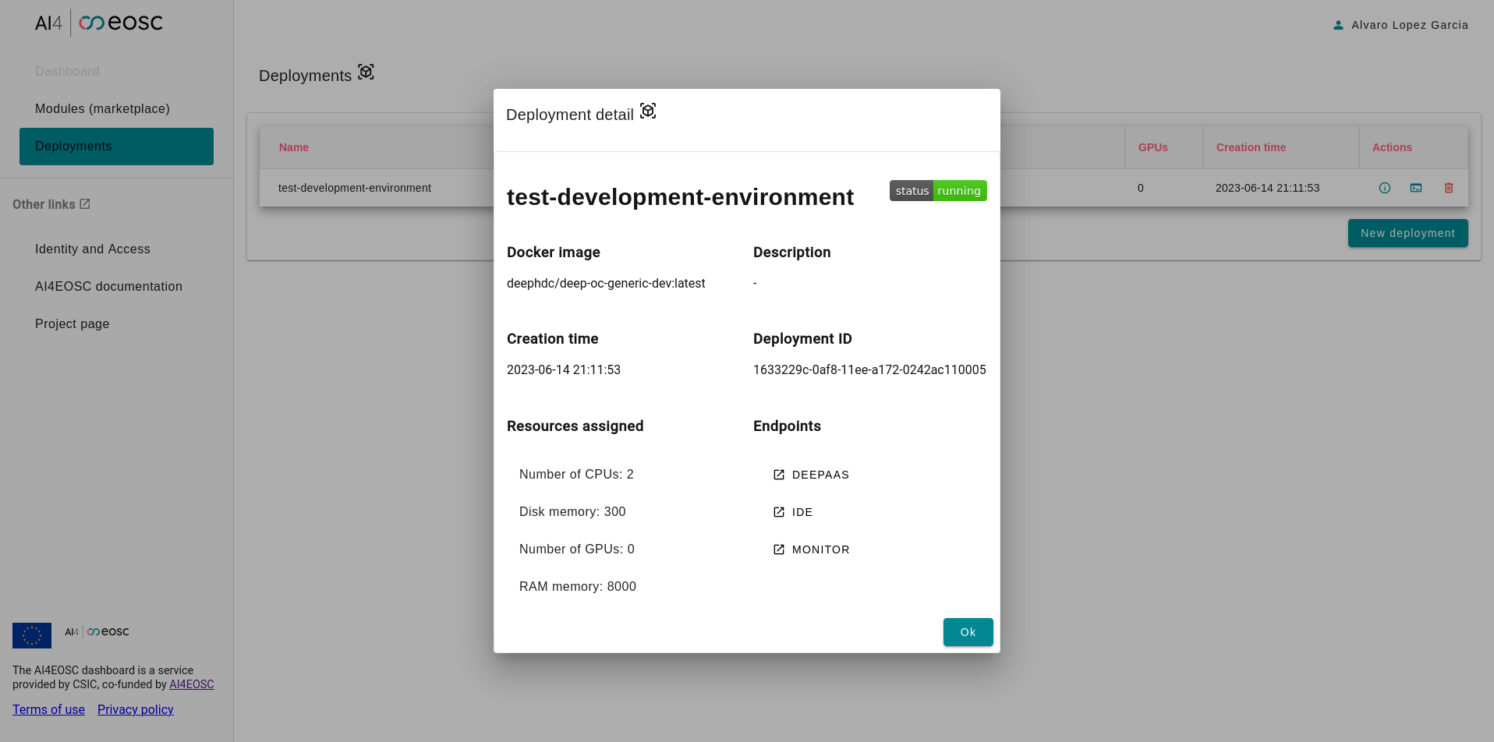
Key impacts and deliverables
AI4EOSC
Increased number of services in the EOSC Exchange
AI/ML generic (AI4EOSC platform) or community specific
Transforming developement of AI models for science in the EOSC
FAIR, reproducibility of pipelines, model provenance
Best practices for development AI and ML models
Improvement of robustness of AI systems -> Trustworthy AI
Drift detection tools and services to assess data/model/inference validity
MLOps infrastructure and services for AI scientists
Provenance of models (reproducibility)
(Main, relevant) Deliverables
AI platform for the EOSC (AI4EOSC platform)
Integrated IDE environments
Advanced ML features: federated learning, homomorphic encription, privacy tools and models
Composite AI, cross discipline pipelines, serverless platforms
Software stack (AI4OS) to build customizez AI platforms
Best-practice documents for the AI community of practice in the EOSC

Slide 7
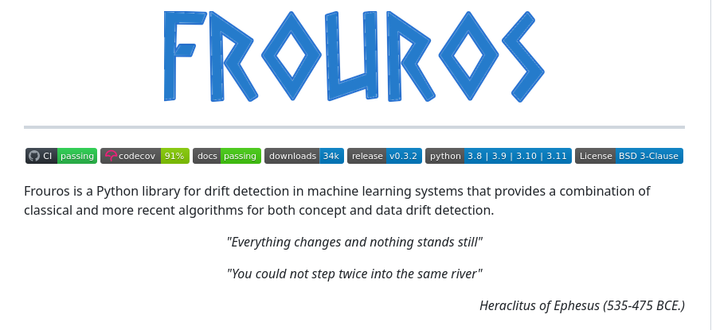
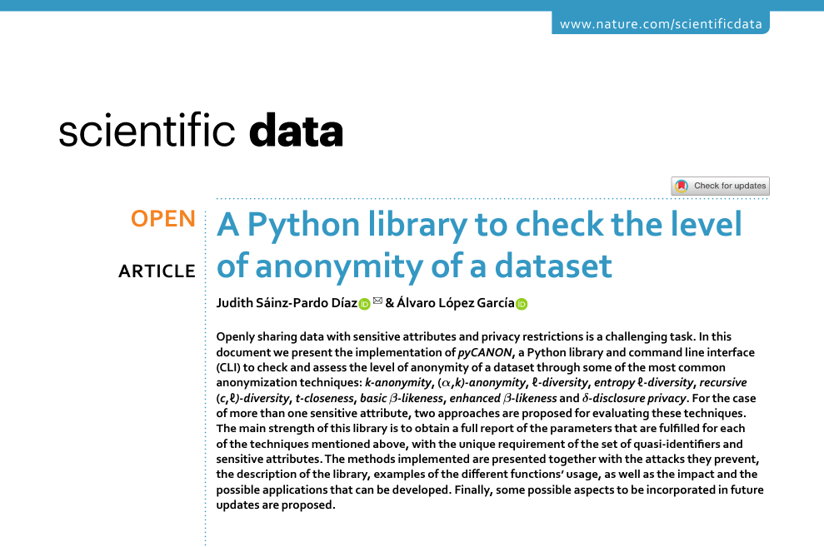
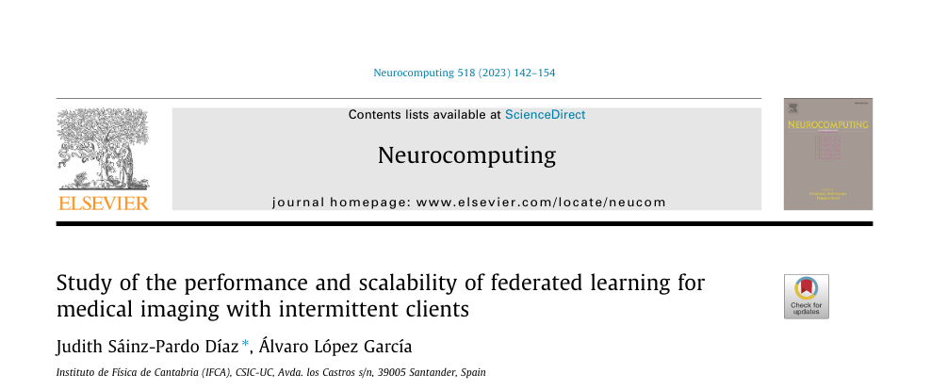
Key impacts and deliverables
AI4EOSC
Increased number of services in the EOSC Exchange
AI/ML generic (AI4EOSC platform) or community specific
Transforming developent of AI models for science in the EOSC
FAIR, reproducibility of pipelines, model provenance
Best practices for development AI and ML models
Improvement of robustness of AI systems -> Trustworthy AI
Drift detection tools and services to assess data/model/inference validity
MLOps infrastructure and services for AI scientists
Provenance of models (reproducibility)
(Main, relevant) Deliverables
AI platform for the EOSC (AI4EOSC platform)
Integrated IDE environments
Advanced ML features: federated learning, homomorphic encription, privacy tools and models
Composite AI, cross discipline pipelines, serverless platforms
Software stack (AI4OS) to build customizez AI platforms
Best-practice documents for the AI community of practice in the EOSC

Slide 8
Background, ecosystem, collaborations
2016 | 2017 | 2018 | 2019 | 2020 | 2021 | 2022 | 2023 | 2024 | 2025 | 2026 | …
DEEP Platform and services
AI4EOSC Enhanced AI Platform for the #EOSC
INDIGO-DataCloud PaaS-based cloud solution for e-Science
DEEP 3 -> AI4EOSC 3 platform
AI4OS -> platform agnostic software stack
uDocker
PaaS Orchestrator
Infrastructure Manager
Identity and Access Manager
DEEP 1 platform
DEEP 2 platform
AI, robotics and AI models integrated into AI4EOSC
DEEP-Hybrid-DataCloud AI/ML/DL PaaS, access to GPUs
FlexiGroBots Fleets of autonomous robots for agriculture
iMagine AI imaging platform for aquatic sciences
AI Compute platform for
the EOSC Compute Platform
EGI-ACE AI services for the EOSC Compute
iMagine platform, powered by AI4OS
Support to SME support
in EOSC DIH
EOSC-Hub
Industry and innovate SME support
Notes:
Technology providers and development: INDIGO, DEEP and AI4EOSC, supporting use cases coming from the EOSC, the EOSC DIH, the EGI-ACE (like INRAE and JRC) and now iMagine

Slide 9
Dependencies and Collaborations
AI4EOSC
Outside EOSC realm:
FlexiGroBots: integrate agriculture & robotics models into the platform
iMagine: exploitation of the platform for the development of AI image tools for aquatic sciences
Exploring collaboration with AI4Europe/AI-on-Demand platform (ongoing) on architecture definition
EOSC-Future
Development of EOSC Interoperability guidelines for AI platforms and services
FAIRCORE4EOSC
PID Graph synergies collaboration started
FAIR-Impact
Proposal for improvement of workflow FAIRness (FAIRness assessment challenge open call)
Potential: FAIR assessment, PID, metadata, ontologies
Potential ones (exploring)
FAIR-EASE: Build earth and environmental services (based on AI)
RAISE: Federated learning for consuming open (and not open) data
Skills4EOSC: training and skills

Slide 10
Your vision
AI4EOSC
Collaboration is key to sucess… but too much collaboration is key to [CENSORED]
Explosion of working groups, interest groups, task forces, remote meetings, in-person meetings, webinars…
Rationalization is needed (i.e. avoid overlap, reiterations of same content, macro alignment)
Time consuming, especially for medium-sized projects
Securing compute and storage resources for high-level services
Currenty bound to consortium participating in R&D projects
EGI-ACE -> EOSC Compute platform, provided services and tools for the EOSC
What next? Engagement of providers is key for EOSC success
SRIA Funding Models
Ordering system (i.e. tracking orders, moderation, usage, etc.) must be taken into consideration (as part of EOSC-Core)

