Slide 1
Contribution of FAIR-IMPACT to the objectives of the EOSC
Strategic Research Innovation Agenda (SRIA)
Vasso Kalaitzi, Ingrid Dillo
15.06.2023

Slide 2
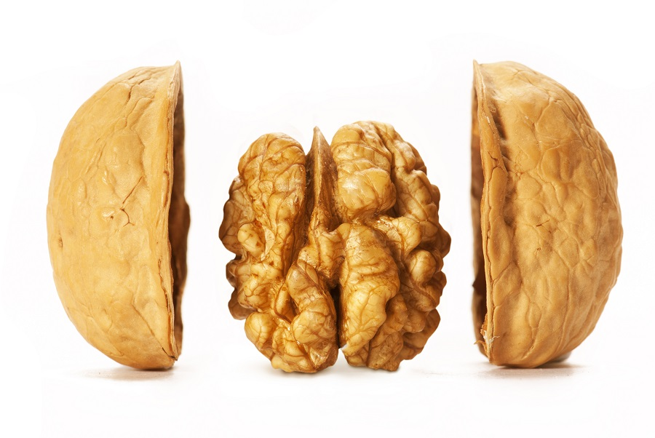
FAIR-IMPACT in a nutshell
Call HORIZON-INFRA-2021-EOSC-01-05
Enabling discovery and interoperability of federated research objects across scientific communities
Expanding FAIR solutions in Europe
Partly following up on FAIRsFAIR
Coordinator: DANS
28 partners and affiliate entities
From 10 EU member states:
NL, FI, FR, DK, IT, DE, ES, NO, BE, RO
and 4 from the UK
Coordination and Support Action
10 million euro
36 months, starting 1 June 2022

Slide 3
The Consortium

Slide 4
FAIR-IMPACT Workplan

Slide 5
Key Results

Slide 6
Contribution to EOSC SRIA per action area: Identifiers
FAIR-IMPACT dedicated WP3 on Working with PID service providers and infrastructures to meet user needs, align with EOSC policy and maximise uptake.
Key actions:
Setting up a coordination mechanism for EOSC PID service providers
Integration of PID practices into FAIR data management
EOSC PID policy alignment & support
PID implementation programme
Expected results
Shared long-term vision for PID service providers on PID usage in EOSC
User guidelines on EOSC PID implementation
Guidelines for creating a user tailored EOSC compliant PID policy
Specific Impact #1: A coherent implementation of PIDs across the EOSC.

Slide 7
Contribution to EOSC SRIA per action area: Metadata and Ontologies
FAIR-IMPACT dedicated WP4 on Greater and more harmonised use of semantic artefacts throughout the EOSC ecosystem, leading to semantic interoperability within and between disciplines.
Key actions:
Semantic artefact disciplinary governance
Semantic artefact lifecycle and catalogues
Standard metadata for research software
A framework to create, document and share semantic artefact crosswalks and mappings
FAIR semantic artefacts in use within data repositories
Expected results
Report on semantic artefact governance models and disciplinary approaches for inclusion within EOSC
Report on FAIR semantic artefact lifecycle from engineering, to sharing and FAIR assessment
Specification of shared metadata description of semantic artefacts and their catalogues including common reference API
Guidelines for recommended metadata standard for research software within EOSC
Guidelines and methodology to create, document and share mappings and crosswalks
Use case driven validation of semantic artefact exploitation within data repositories
Specific Impact #2: Federated research objects in EOSC enabled by better governance of FAIR semantic artefacts and clear, common ways to interact with metadata and ontologies.

Slide 8
Contribution to EOSC SRIA per action area: FAIR Metrics and certification 1/2
FAIR-IMPACT dedicated WP5 on Building on and extending current FAIR metrics, assessment tools and Trustworthy Digital Repository (TDR) requirements to meet the needs of more thematic domains and a wider range of digital research objects.
Key actions:
FAIR digital object assessment pilots in a disciplinary context
FAIR metrics for research software
Semantic artefact FAIRness assessment
FAIR data and code in FAIR-enabling TDRs
Expected results
Implementing metrics for automated FAIR digital objects assessment in a disciplinary context
Metrics for automated FAIR software assessment in a disciplinary context
Final recommendations on implementing and exposing FAIR assessments for data and code
Specific Impact #3: Adapted guidelines and frameworks for FAIR data, research software, semantic artefacts. FAIR enabled at Trustworthy Digital Repositories (TDRs) through the functional assessment of repository trustworthiness and data FAIRness.

Slide 9
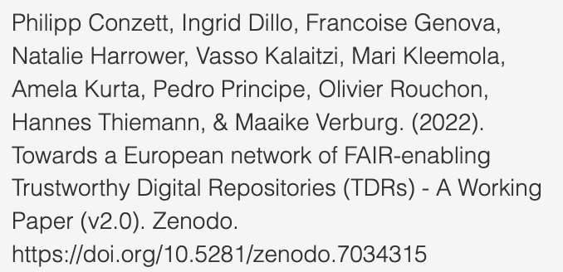
Contribution to EOSC SRIA per action area: FAIR Metrics and certification 2/2
FAIR enabled at Trustworthy Digital Repositories (TDRs) through the functional assessment of repository trustworthiness and data FAIRness.
Need for:
Network of FAIR-enabling TDRs => voice of existing and aspiring TDRs => advocacy, networking, knowledge exchange, coordination and development
Design, implement and deliver technical integration of Network with data services and repositories within the EOSC
Design, implement and deliver federated access to data provided by the Network

Slide 10
Contribution to EOSC SRIA per action area: EOSC Interoperability Framework
FAIR-IMPACT dedicated WP6 on Designing and promoting interoperability mechanisms across domains and institutions and foster global
alignment of FAIR frameworks.
Key actions:
Semantic and Technical core interoperability across domains
Legal and Organisational interoperability
Interoperability within the EOSC ecosystem
Expected results
Guidelines for the usage of components for technical and semantic interoperability in cross-domain use cases
Core metadata schema for legal interoperability
MoU and Service Level Agreement templates for data interoperability
Cross-domain recommendations and feedback for the EOSC Interoperability Framework
Specific Impact #4: Increased data accessibility for researchers and other European data users and stakeholders.

Slide 11
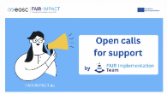
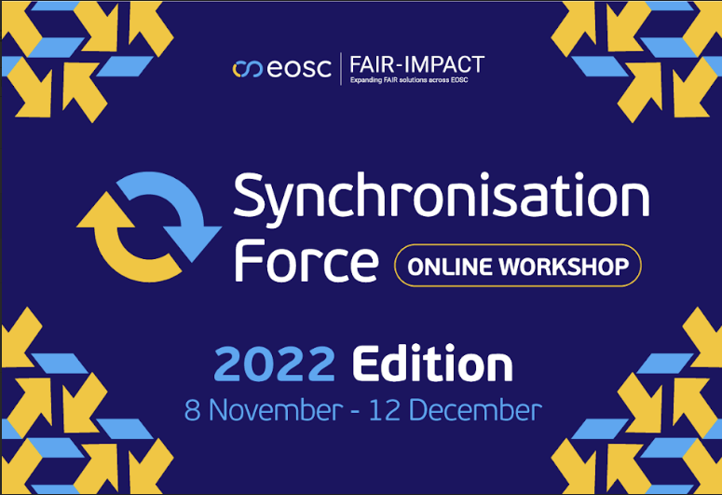
Also contributing to:
Rules of participation
Landscape monitoring
Aligning expected results with previous EOSC developments
Specific Impact #5: Active, engaged and informed research communities supporting the implementation of an operational, open and FAIR EOSC ecosystem through increased uptake and adoption at cross-domain and pan-European level.
Specific Impact #6: Clear and functioning mechanisms for supporting the governance, coordination, and collaboration activities carried out by the EOSC Partnership.

Slide 12
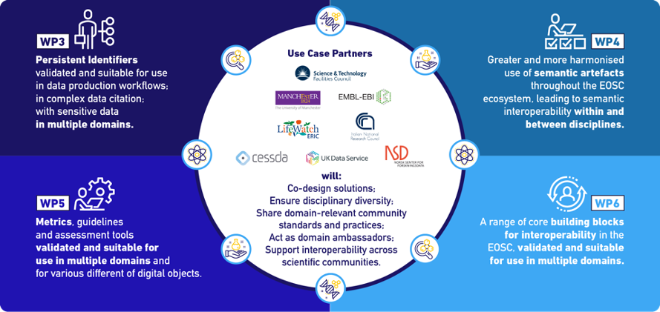
FAIR-IMPACT Integrated Use cases

Slide 13
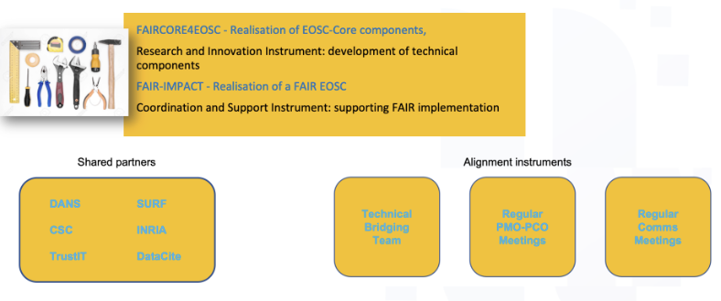
Sister project collaboration

Slide 14
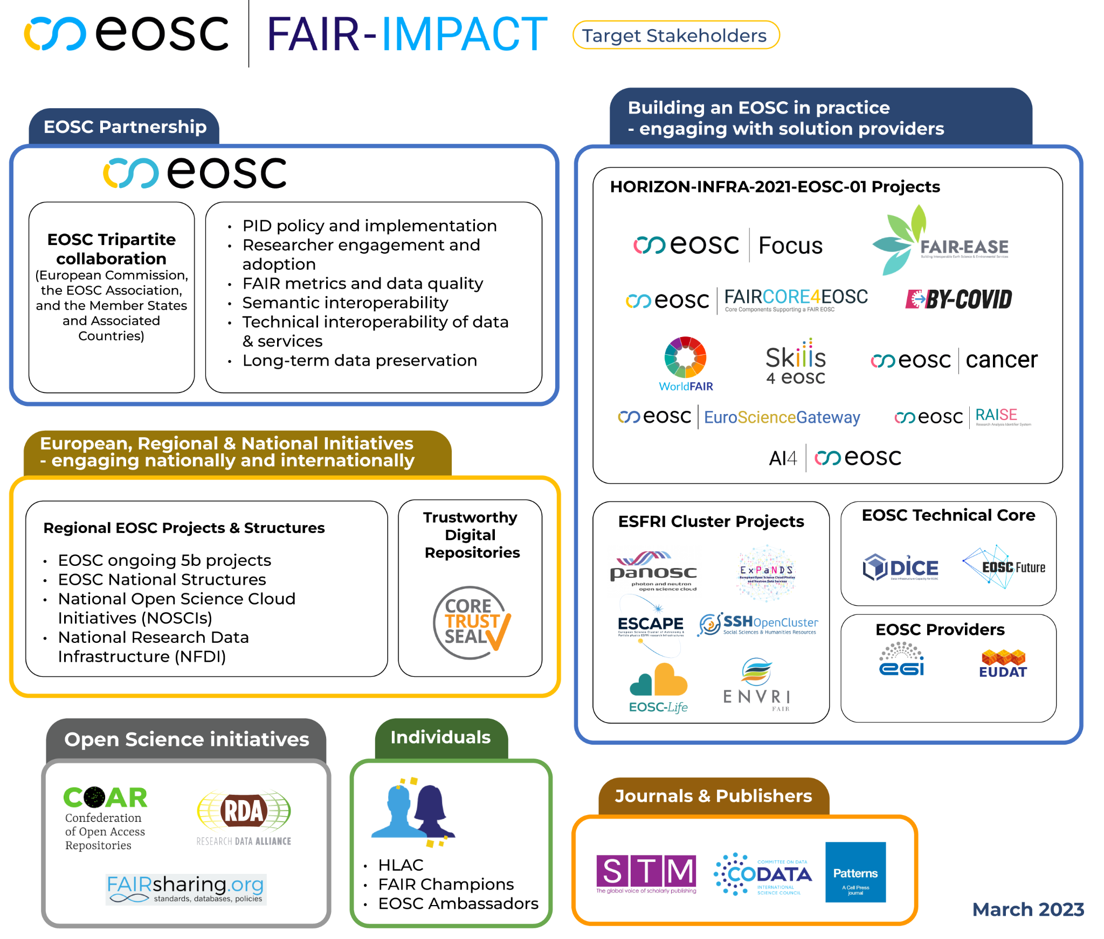
Target stakeholders and other collaborations

Slide 15
FAIR IMPACT Overall objective

