Slide 1
Addressing the implementation of an Open Science strategy- focus open data
Anna Lundhagen, Swedish University of Agricultural Sciences (SLU)
Pro Vice-Chancellor, Collaboration and Environmental Monitoring and Assessment
Associate Professor, ecology and population genetics
former Head of Department

Slide 2
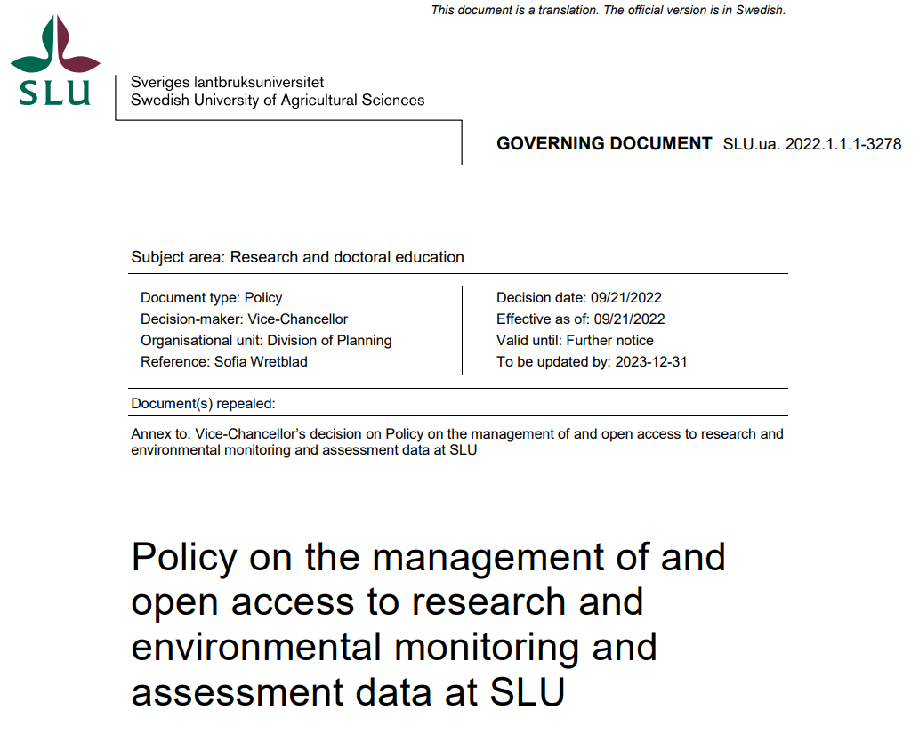
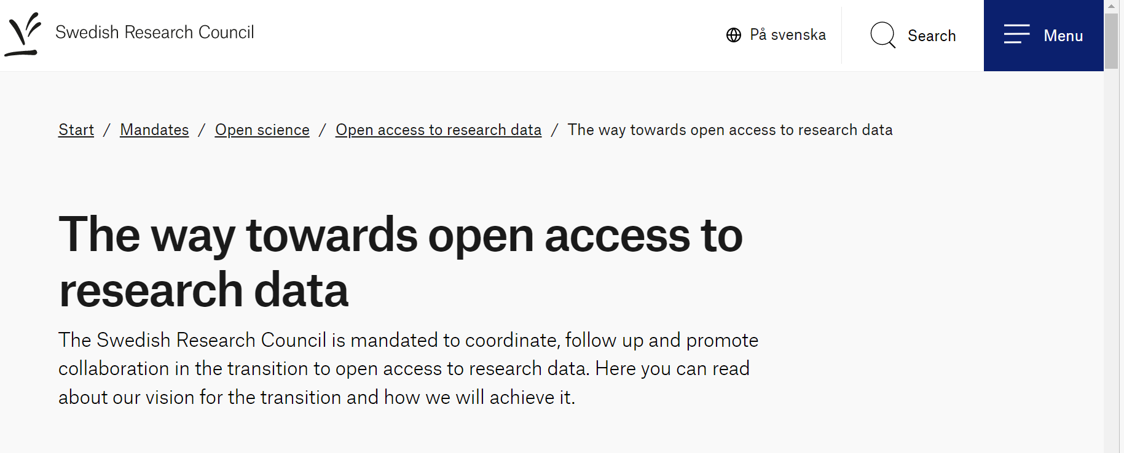

Slide 4
Data management
Data protection and personal data
Statistics and data support
Further use of research output
Registration
Publication of publications
Storage of data during projects, capacity for calculations, Software
Data management plan (DMP)
Storage for archived data
Search for data
Archiving of data
Personal data and contract management
Document and validate
Add metadata
Revise DMP
Publication of data
- Persistent identifiers
Advice on repositories and infrastructures
Open data formats
Plan data management
Collect, organise, and store data
Process and
analyse data
Archive and preserve data
Share and publish data
Discover, reuse, and cite data

Slide 5
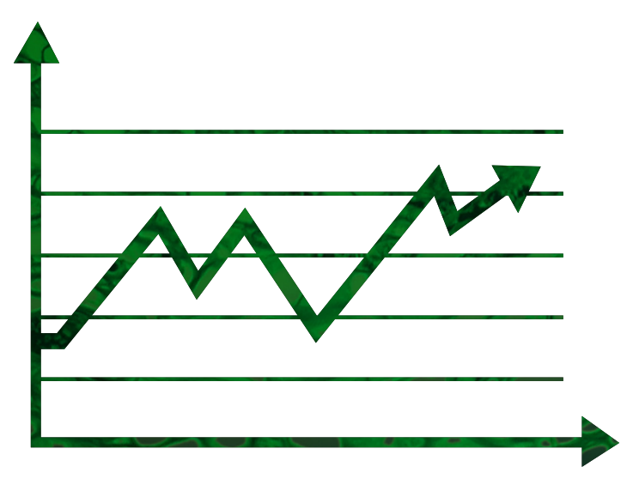
What´s in it for me?
researcher

Slide 6
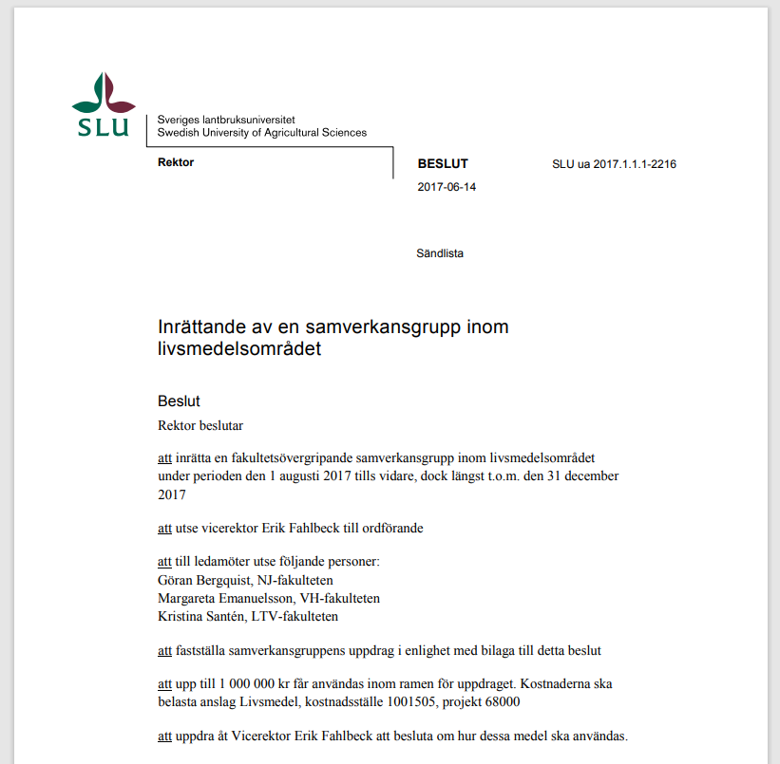
What tools do I have?
§
Head of Dept

Slide 7
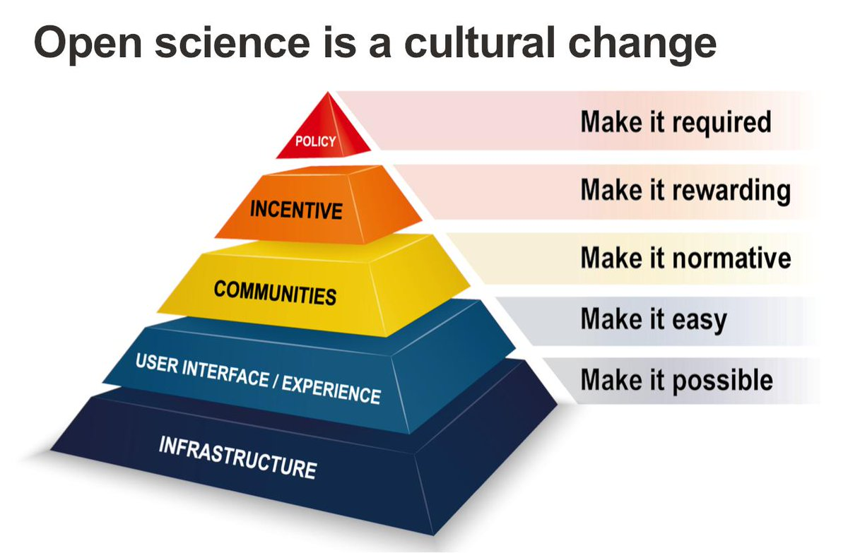
Open Science means a practical and cultural change
Illustration: EPFL Open Science

Slide 8
Open data
~
~
~
~
Illustration: EPFL Open Science

Slide 9
Environmental monitoring and assessment (EMA)
Delivers science-based decision support to reach environmental objectives

Slide 10
Steering committee
- top management and active feedback system
- resources for development
- focus on interfaces, routines and actual needs
Pro Vice-Chancellor
Head of
Library
Head of
IT dept
Head of
Legal Affairs
and Archive

Slide 11
local, nat. and internat.
updated in their field
Data management
support function
Back office
IT department
Front desk
Legal affairs
University library
Archive
Information management
Registry

Slide 12
Data management
support function
Back office
IT department
Front desk
Legal affairs
University library
Archive
Information management
Data Management Plan
Registry

Slide 13
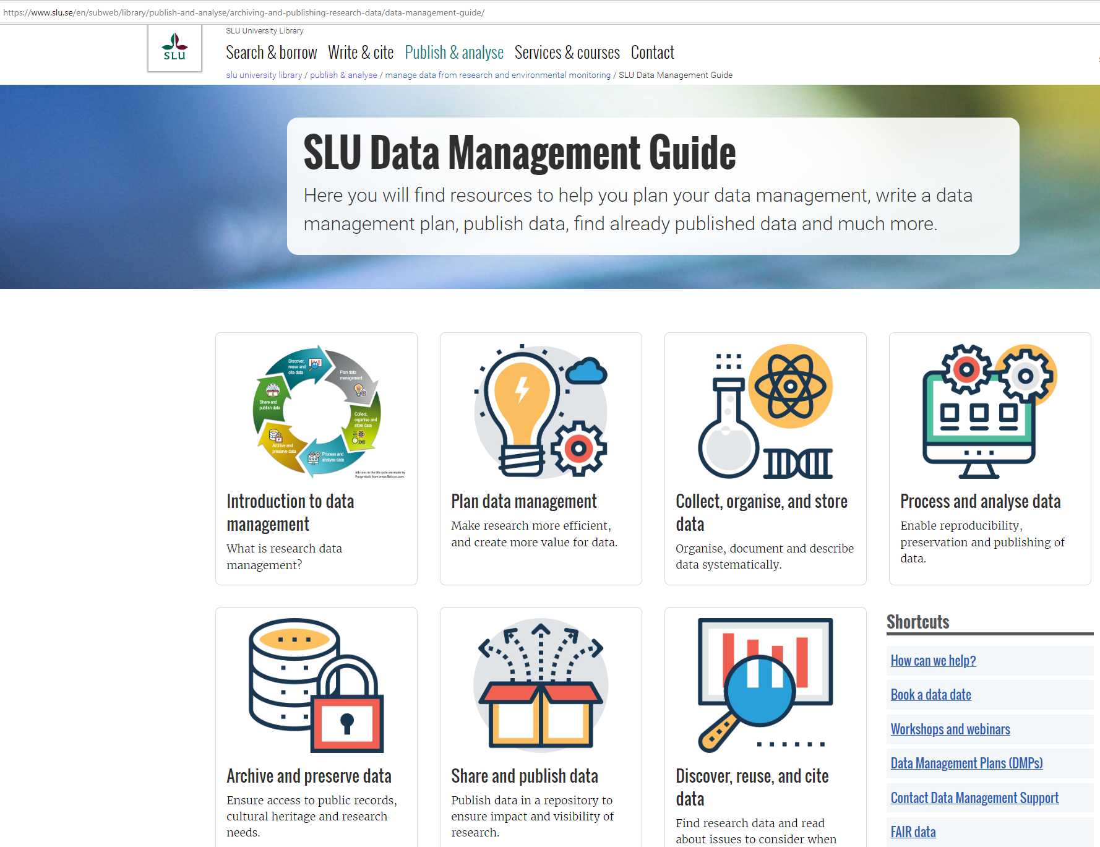

Slide 14
Challenges and questions
Technical and legal capacity
storage/handling, recruitment challenges
Connect very different expertise
”translators”
Support systems and expecations
be patient and realistic

Slide 15
Open Science promote quality and new knowledge
through shared responsibility and appropriate support
Illustration: EPFL Open Science

Slide 16
Thank all of you who make this change possible and thank you for your attention!

