Slide 1
The Swedish Research Council and EOSC
Sumithra Velupillai
Senior Research Officer
Notes:
https://eosc.eu/events/we-accelerate-transition-open-science
joint session on Accelerating the Transition to Open Science: the possible pathways for impact to accelerate the transition to Open Science as the norm for scientific publishing.

Slide 2
What we do
Sweden’s largest governmental research funding body at Swedish universities, colleges and institutes.
Advises the Government on research policy
Works to ensure that research benefits society
Notes:
We are Sweden’s largest governmental research funding body. We also advice the Government on research policy, and work to ensure that research benefits society
Från basmallen på Navet – ha med någon bild?
Jag tycker bilden är felplacerad. Har vi ingen finare bild på VR, t ex huset eller kontoret. Annars lägg bilden på rätt ställe (centrerat, mindre?)

Slide 3
Sweden’s Presidency of the Council of the EU
Informal Competitiveness council meeting, Stockholm, Sweden (8 Feb)
Council conclusions on high-quality, transparent, open, trustworthy and equitable scholarly publishing (23 May)
Conference: The Potential of Research Data: How Research Infrastructures Provide New Opportunities and Benefits for Society, Lund, Sweden (19-20 June)
Focus on research data and research infrastructures
Accelerate transition to open science
Use data from research infrastructures to tackle societal challenges
The digital revolution creates new opportunities for publishing and data sharing
Notes:
During the Swedish Presidency for research and higher education, there is a focus on research data and research infrastructures. The goal is to accelerate the transition to open science, to use data from research infrastructures to tackle societal challenges – to capture the new opportunities for publishing and data sharing that the digital revolution enables.
Within this, there has been some activities, such as the Informal competitiveness council meeting in Stockholm in February, Council conclusions on high-quality, transparent, open, trustworth and equitable scholarly publishing from the 23rd May, and an upcoming conference entitled The potential of research data – how research infrastructures provide new opportunities and benefits for society, in Lund next week – where a Declaration is planned.

Slide 4
Open access to research data and EOSC
The Swedish Research Council (SRC) is commissioned by the Swedish Government to:
coordinate, follow-up and promote collaboration on the national work on open access to research data.
coordinate and promote the Swedish engagement in EOSC
SRC is the Swedish mandated organisation in the EOSC Association
Supports the governmental representation as an expert state agency in the EOSC Steering Board
Notes:
In the area of open access to research data and Eosc – we are commissioned by the Swedish government to coordinate, follow-up and promote collaboration on the national work on open access to research date, as well as to coordinate and promote the Swedish engagement in EOSC. The SRC is the Swedish mandated organization in the EOSC Association, and we support the governmental representation as an expert state agency in the EOSC Steering Board.
There are other commissions to other state agencies in Sweden – the National Library has the equivalent assignment on open access to scientific publications, and an assignment to develop national guidelines on open science, where the SRC advices. Universities and higher education institutes have the assignment to continue to develop the work on open science.
Open access to research data
The National Library has the equivalent assignment on open access to scientific publications
assignment to develop national guidelines on open science.
Universities and Higher Education institutions have the assignment to continue to develop the work on open science.

Slide 5
Why is participation in EOSC important?
To align the national work on open access to research data with EOSC
Part of the national strategy for participation in Horizon Europe
An opportunity for the Swedish research community to contribute to the vision of an open science system
Notes:
Why then is participation in EOSC important? From our perspective, it is an important part of the national work on open access to research data, aligning these – and the other way around – EOSC can help moving the national development forward. It is also part of the national strategy for participation in Horizon Europé, and an opportunity for the Swedish research community to contribute to the vision of an open science system.

Slide 6
Open access to research data and EOSC - some of our activities
Recommendations and guidelines
Initiatives that contribute to increased knowledge and cultural change
Initiatives to promote the long-term usability of research data, including FAIR data management, and data management plans
Supporting organisations engaged in EOSC
An appointed external reference group for open access to research data and EOSC

Slide 7
Activities in relation to the EOSC General Objectives
GO1: Open science becomes the "new normal"
Recommendation on open access to research data
Initiatives that contribute to increased knowledge and cultural change
Handbook on open access to research data
Incentives and merits for open access to research data
Picture: Unsplash
Notes:
Seminarier, vägledande material mm
CoARA – and internal work

Slide 8
Activities in relation to the EOSC General Objectives
GO2: Standards, tools and services (data)
Requirements for research data management plans
Coordination of research data management plans
Criteria and recommendations for FAIR research data
Surveying processes for open and FAIR research data in different disciplines
Picture: Unsplash
Notes:
Sunets DHP tjänst!

Slide 9
Activities in relation to the EOSC General Objectives
GO3: Sustainable and federated infrastructures
Financing data management and research infrastructures with specific requirements to support open access to data
Picture: Unsplash
Notes:
Kommentar från MN: Här kan man tex nämna SND och NAISS, ev också nämna just e-infrastrukturer specifikt
Ställer vi inte krav på RI i våra särskilda villkor?
Här finns väl också exempel från Sunet inom det de gör, t ex inom EOSC future osv (borde vi förresten samla på oss)

Slide 10
National work on open access to research data
Focus areas
Strategic directions
Implemen-tation
Knowledge building and awareness
Data management
Incentives
Mapping, analysis and assessment
Indicators for follow-up
Surveys and hearings to key stakeholders
Notes:
Stakeholder groups: RPOs, RFOs, RIs, researchers

Slide 11
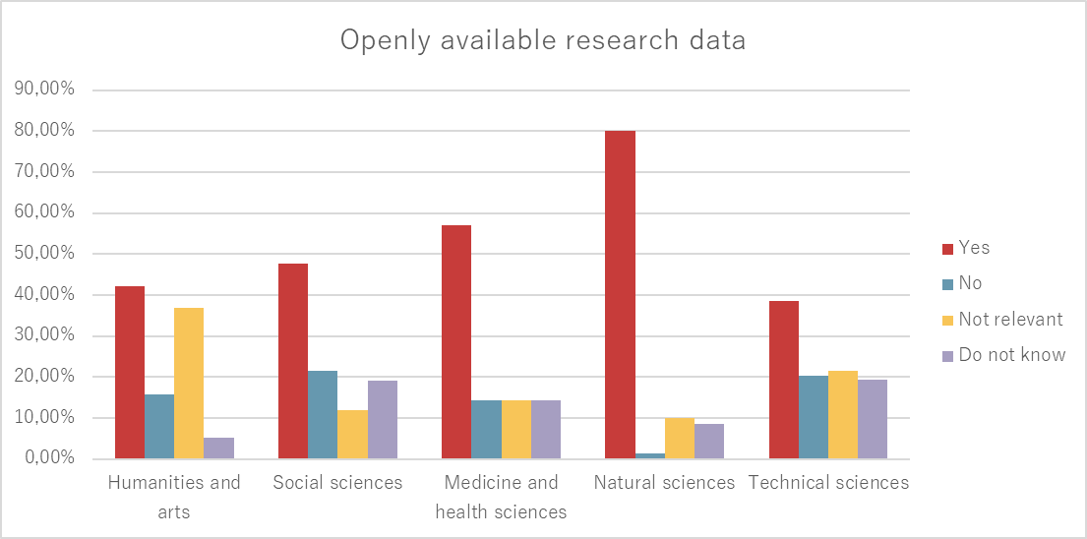
Summary results 2022
Research data is made openly available (”as closed as necessary”) to a large extent (~50%)
Difficulties navigating the landscape of guidelines and recommendations from different actors
Needs: support, common solutions and infrastructures
Responses from researchers (n=274) to the question ”Are or will research data be made openly available”?
Notes:
But more can be done
Openly available – including metadata but not necessarily FAIR
Du behöver kommentera att de som svarat Kanske inte är rätt urval – och känna till urvalet. Är det inte så att de som svarat är de som är mer benägna att göra tillgängligt?

Slide 12
Summary and reflections
Yearly assignment – will be followed-up and developed
We now have a ”baseline”
Working on further coordinating/aligning national work and EOSC
Still a lot of work to do, on all levels
Notes:
Poängtera att vi har ett årligt uppdrag, kommer att följa och utveckla detta löpande

Slide 13
Thank you!
Contact: openscience@vr.se
If not otherwise stated, illustrations from unsplash.com

