Slide 1
EOSC Steering Board
National Tripartite Event
Sofia, 28 March 2023

Slide 2

EOSC is transitioning
EOSC is transitioning to a more stakeholder-driven approach with a shared vision, common objectives and complementary contributions at European, national and institutional levels.
A co-investment (with in kind and financial contributions) by the EU and non-EU partners of at least €1 billion is foreseen for the next 7 years.
Overall progress is steered by a new EOSC tripartite governance involving the EU represented by the European Commission, the participating countries represented in the EOSC Steering Board and the research community represented by the EOSC Association.
Notes:
The European Open Science Cloud (EOSC) is an environment for hosting and processing research data to support EU science.
The ambition of the European Open Science Cloud (EOSC) is to provide European researchers, innovators, companies and citizens with a federated and open multi-disciplinary environment where they can publish, find and re-use data, tools and services for research, innovation and educational purposes.
This environment will operate under well-defined conditions to ensure trust and safeguard the public interest.
The EOSC enables a step change across scientific communities and research infrastructures towards
seamless access
FAIR (Findability, Accessibility, Interoperability and Reusability) management
reliable reuse of research data and all other digital objects produced along the research life cycle (e.g. methods, software and publications)
This includes joint activities to enable and monitor the uptake of open science practices in Europe and to align relevant national and EU policies and investments to improve the production of FAIR research output that are “as open as possible, as closed as necessary”.

Slide 3
EOSC-SB overview
EOSC - European data space for science, research and innovation
Representatives of MS/AC – usually from relevant
Ministries
To create a common understanding between the
Commission, the Member States and the countries
associated to the Research and Innovation
Framework Programme on the direction of policy
developments required for achieving the strategic,
political and implementation objectives of the EOSC
To pursue synergies and alignment of national
policies and investments relevant to the European
Open Science Cloud
93 representatives from Members and Observers
27 Member States
16 Associated countries
2 Observers (incl. EOSC Association)
16 countries associated to the Horizon Europe
Framework Programme (September 2022)
invited:
Albania, Armenia, Bosnia and Herzegovina, Faroe
Islands, Georgia, Iceland, Israel, Kosovo, Moldova,
Montenegro, Norway, North Macedonia, Serbia,
Tunisia, Turkey, and Ukraine
Notes:
The EOSC Steering BoardEN••• (EOSC-SB) was established as an expert group of the European Commission to strategically advise on EU policy for research data infrastructures and services and the alignment of EU and national policy developments and investments with the EOSC objectives.
The expert group also supports the Commission in coordinating and implementing the EOSC as part of the ERA Policy Agenda, in line with the Council conclusions of 26 November 2021EN••• on the new ERA Governance.

Slide 4
EOSC-SB Monitoring survey 2021
National EOSC-supporting policies and investments
Goals
□ Understand what contributions will be made by MS/AC to further develop EOSC, in synergy with the implementation of the SRIA on a European level, and reach a collective understanding on how to assess these contributions, building on the experience acquired by the Member States when communicating ex-ante commitments in response to Commissioner Gabriel’s invitation in
July 2020;
□ Evaluate how MS/AC support their organisations nationally, what are their data-related policies and financing mechanisms? What do MS/AC do on country level to advance FAIR and EOSC?
□ Evaluate how national funding (other than from members of the EOSC Association) complements the contributions provided by the Association members; and
□ Work together with the EOSC Association, and liaise with the EC, so that the benchmarking and monitoring is strategic, fit for its purpose of an overall coordination of the implementation and operationalisation of the EOSC ecosystem in line with the SRIA priorities, and without duplication
Objectives
A.) Benchmarking of activities on international, national, regional, and institutional level
1. developing and implementing policies and supporting EOSC-ready infrastructures and
initiatives; and
2. providing contributions/investments and financing of EOSC relevant policies, infrastructures, and initiatives.
B.) Monitor the benefits of MS/AC policies to the whole EOSC and the benefits of EOSC to the
national research communities
Notes:
In the EOSC, a large number of stakeholders work together to create the European web of research data and services. This requires a significant investment of money, resources, and work from all partners involved. The EOSC Association, the European Commission, and the EU member states and associated countries each have to provide their share to make the EOSC a success story.

Slide 5
Steering Board Policy Issues
The SB has identified three Policy Issues to be addressed as building blocks of the Tripartite strategy for 2022:
a) Data literacy including definitions and the potential of education and teaching
b) EOSC and the private sector
c) EOSC sovereignty on FAIR data
Three discussion papers prepared by the SB-policy-subgroup - now adopted and published as position papers.
Work is to start in 2023 on the following Policy Issues:
- EOSC configuration for post 2027
EOSC data productivity
Digitalization of research

Slide 6
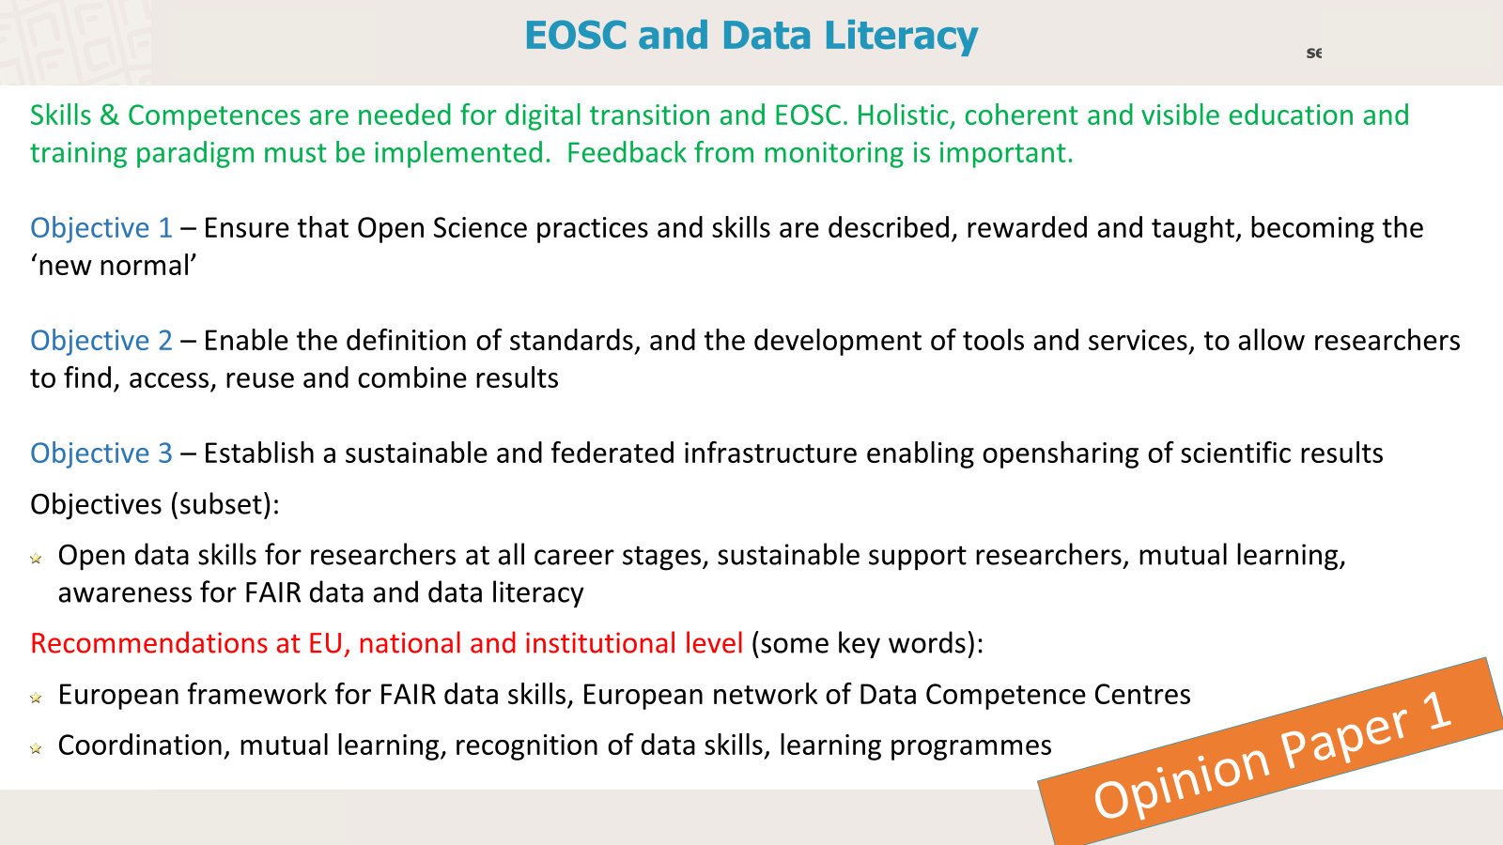


EOSC and Data Literacy
Skills & Competences are needed for digital transition and EOSC. Holistic, coherent and visible education and training paradigm must be implemented.-
Objective 1 – Ensure that Open Science practices and skills are described, rewarded and taught, becoming the ‘new normal’
Objective 2 – Enable the definition of standards, and the development of tools and services, to allow researchers to find, access, reuse and combine results
Objective 3 – Establish a sustainable and federated infrastructure enabling opensharing of scientific results
Objectives (subset):
Open data skills for researchers at all career stages, sustainable support researchers, mutual learning, awareness for FAIR data and data literacy
Recommendations at EU, national and institutional level (some key words):
European framework for FAIR data skills, European network of Data Competence Centres
Coordination, mutual learning, recognition of data skills, learning programmes
Opinion Paper 1

Slide 7
EOSC and Commercial Partners
Participation by commercial partners (as users/providers) provides opportunities and risks.
Objectives (subset):
concept for effective collaboration between all sources of competence that share the vision of an open science and innovation system
Recommendations at EU and national (some key words):
Analyse risks/benefits, review RoP, explore synergies (e.g. with GAIA-X, data spaces)
Coordinate investment at national level, discuss in national tripartite events
FOLLOW-UP: Procurement
Opinion Paper 2

Slide 8
FAIR data sovereignty in EOSC
FAIR data are common goods; responsibilities to protect FAIR data value of use and reuse
Objectives (subset):
Sovereignty on research FAIR data (SFD) as common practice (EOSC tripartite, research communities, developers and operators of the EOSC)
Recommendations at EU and national (some key words):
RoP evolve with quality standards, EOSC Interoperability Framework development, guidelines
Contributors clearly identified, national EOSC-ready nodes and policies, quality assurance
Opinion Paper 3

Slide 9
Monitoring Open Science
Deploy Open Science principles, share best practices and monitor evolution; MS/AC support the EOSC through financing/making available EOSC-needed e-infrastructures and research organisations, and through contributions to European policy developments. Motivation helps to recognize/share good practices (What that works can be adopted by other partner countries, status of actual investments, evolution in the ERA context and beyond
Objectives (subset):
one-stop-shop for Open Science monitoring, identify gaps, make information as open as possible to all
Recommendations at national and institutional level (some key words):
Aim at large participation in Open Science at national and institutional level
Reach a number of ambitious targets by 2024
EOSC SB to discuss, communicate, validate, develop and refine policies
Opinion Paper 4

Slide 10
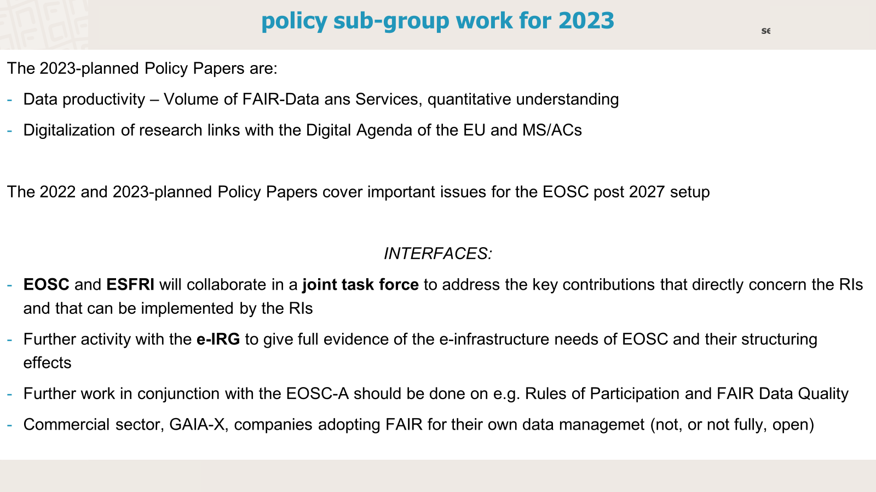

Slide 11
EOSC Steering Board Statement
We, the EOSC Steering Board collectively:
Recognise EOSC as the overarching transverse European Data Space for research. EOSC shall be implemented as orthogonal and supplementary to the thematic European Data Spaces, which in turn should capitalise on expertise and solutions developed in the context of EOSC.
Recognise EOSC to be an accelerator of the digital transition, comprising FAIR digital objects as well as people with data science and management competences.
Reaffirm the importance of the sovereignty of the research sector as FAIR data provider in EOSC
Invite to open EOSC to the public sector at large and to partners from the commercial sector that are dedicated to Open Science, considering them as providers and users of the EOSC ecosystem, which is developed to be a public good.
Call all research and innovation stakeholders to commit to making Open Science the new normal, and to achieve this goal develop and deploy the necessary science policies and supplementary financial investments.
Commit to support the progress towards Open Science and the advancement of EOSC implementation by facilitating monitoring, exchanging practices, and promoting mutual learning across countries and communities.

