Slide 1


National Tripartite Event EOSC
Bulgaria
Open Science Memorandum of understanding of RPOs
Prof. Aneta Karaivanova, IICT-BAS

Slide 2
National OS Initiative in Bulgaria:
Open Data and Cloud Computing
On December 9, 2021, nine scientific organizations signed a Memorandum of Understanding (MoU) establishing the National Open Data and Cloud Computing Initiative (NI ODCC) in order to create:
  synergies at national level between organizations with a role and interest in the European Open Science Cloud
  integration of open data infrastructures (storage) and cloud computing (services and resources) in the EOSC
  supporting activities to optimize services for research and innovation;
  sharing and disseminating information about the infrastructure, services and expertise of the participants, about their work and achievements.
The final document was prepared after a 6 months’ intensive work of an initiative WG following the recommendations given at the EOSC symposium in 2021 and by the models, developed in the framework of NI4OS-Europe project, and several presentations including the discussion during the National Information Day on Open Science held in September 2021.

Slide 3
Open Data and Cloud Computing National Initiative: the partners
The coordinating organization of the initiative is the Institute of Information and Communication Technologies, Bulgarian Academy of Sciences (www.iict.bas.bg ).
Partners are 5 Bulgarian universities and 4 institutes of the BAS:
  Sofia University "St. Kliment Ohridski ” (www.uni-sofia.bg )
  Technical University – Sofia (www.tu-sofia.bg )
  Medical University – Sofia (www.mu-sofia.bg)
  University of Plovdiv “Paisii Hilendarski” (www.uni-plovdiv.bg )
  University of Library Studies and Information Technologies – Sofia
  (www.unibit.bg )
  The Institute of Mathematics and Informatics (www.math.bas.bg )
  The National Institute of Geophysics, Geodesy and Geography
  (www.niggg.bas.bg )
  The Institute of Mechanics (www.imbm.bas.bg )
The MoU remains open for new members to join

Slide 4
MoU: objectives
Objective 1: Creating synergy at the national level between organizations that have a role and interest in EOSC, optimizing national activities with a view to integration of national infrastructures related to open data and cloud computing
Objective 2: Provide support to the research community at national level regarding the implementation of "Open Science" and "Open Science Cloud" policies in accordance with European recommendations and policies and provide support for the development of capabilities, specific to Open Science;
Objective 3: Contribute to the identification, creation and administration of national open data resource infrastructures and services specific to the "Open Science Cloud" and compatible with the EOSC for the benefit of the research community.

Slide 5
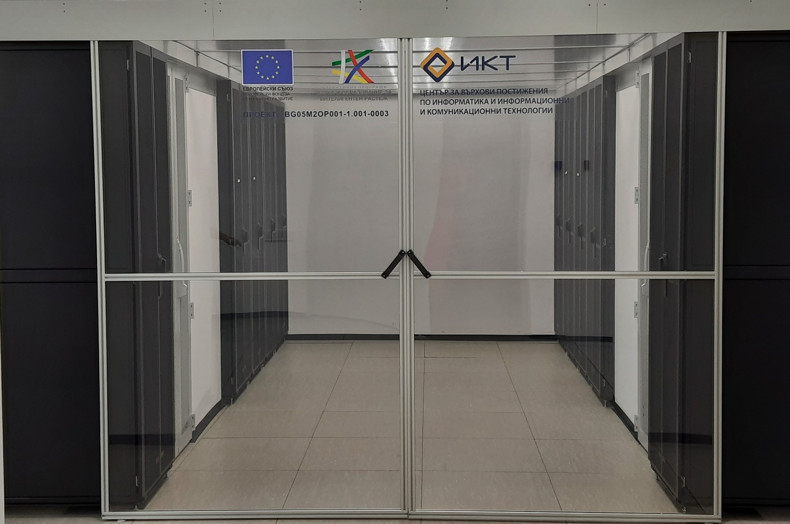
E-Infrastructure facilities
Avitohol supercomputer (top500 system), IICT
System for Data storage for 6.72 PB of data, IICT
3 HPC systems, SU and TU
NVIDIA V100-based servers, IICT, IMI, PU, MU, UniBIT, PU, IMeh, NIGGG
Comprehensive portfolio of systems and services, capable of serving diverse needs

Slide 6
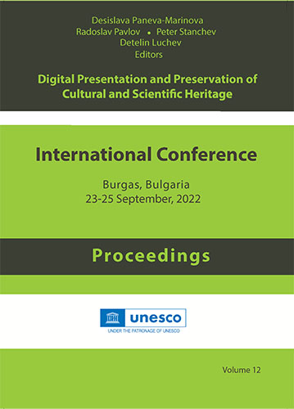
2022: implementation
In 2022 the team already started with:
  Identification of digital resources, general and thematic cloud services owned by the partners
    Thematic services for onboarding to EOSC catalogue
  Development and provision of training materials on open data and cloud computing to the academic community;
    Translated into Bulgarian
  Technical assistance to ensure compliance with EOSC requirements;
  Promotion of EOSC and FAIR principles and their adoption by scientific data providers;
    2 trainings
  Organization of the National Information Day on Open Science, 23 September 2022 (hybrid event)
  Summarizing the OS activities and achievements during the last year in a paper (OA)

Slide 7
Conclusion
The Bulgarian National OS Initiative is built upon a successfully working consortium
  Considerable knowledge and expertise within the consortium
Expanding the scope of activities
Good relations with MES and NACID
We acknowledge the EOSC related projects (with Bulgarian participation): NI4OS-Europe, EGI-ACE, Skills4EOSC, VI-SEEM, OpenAir, etc., for inspiration and help.

